Slide 1
Rapid Adaptation
Pinus contorta
Data exploration

Slide 2
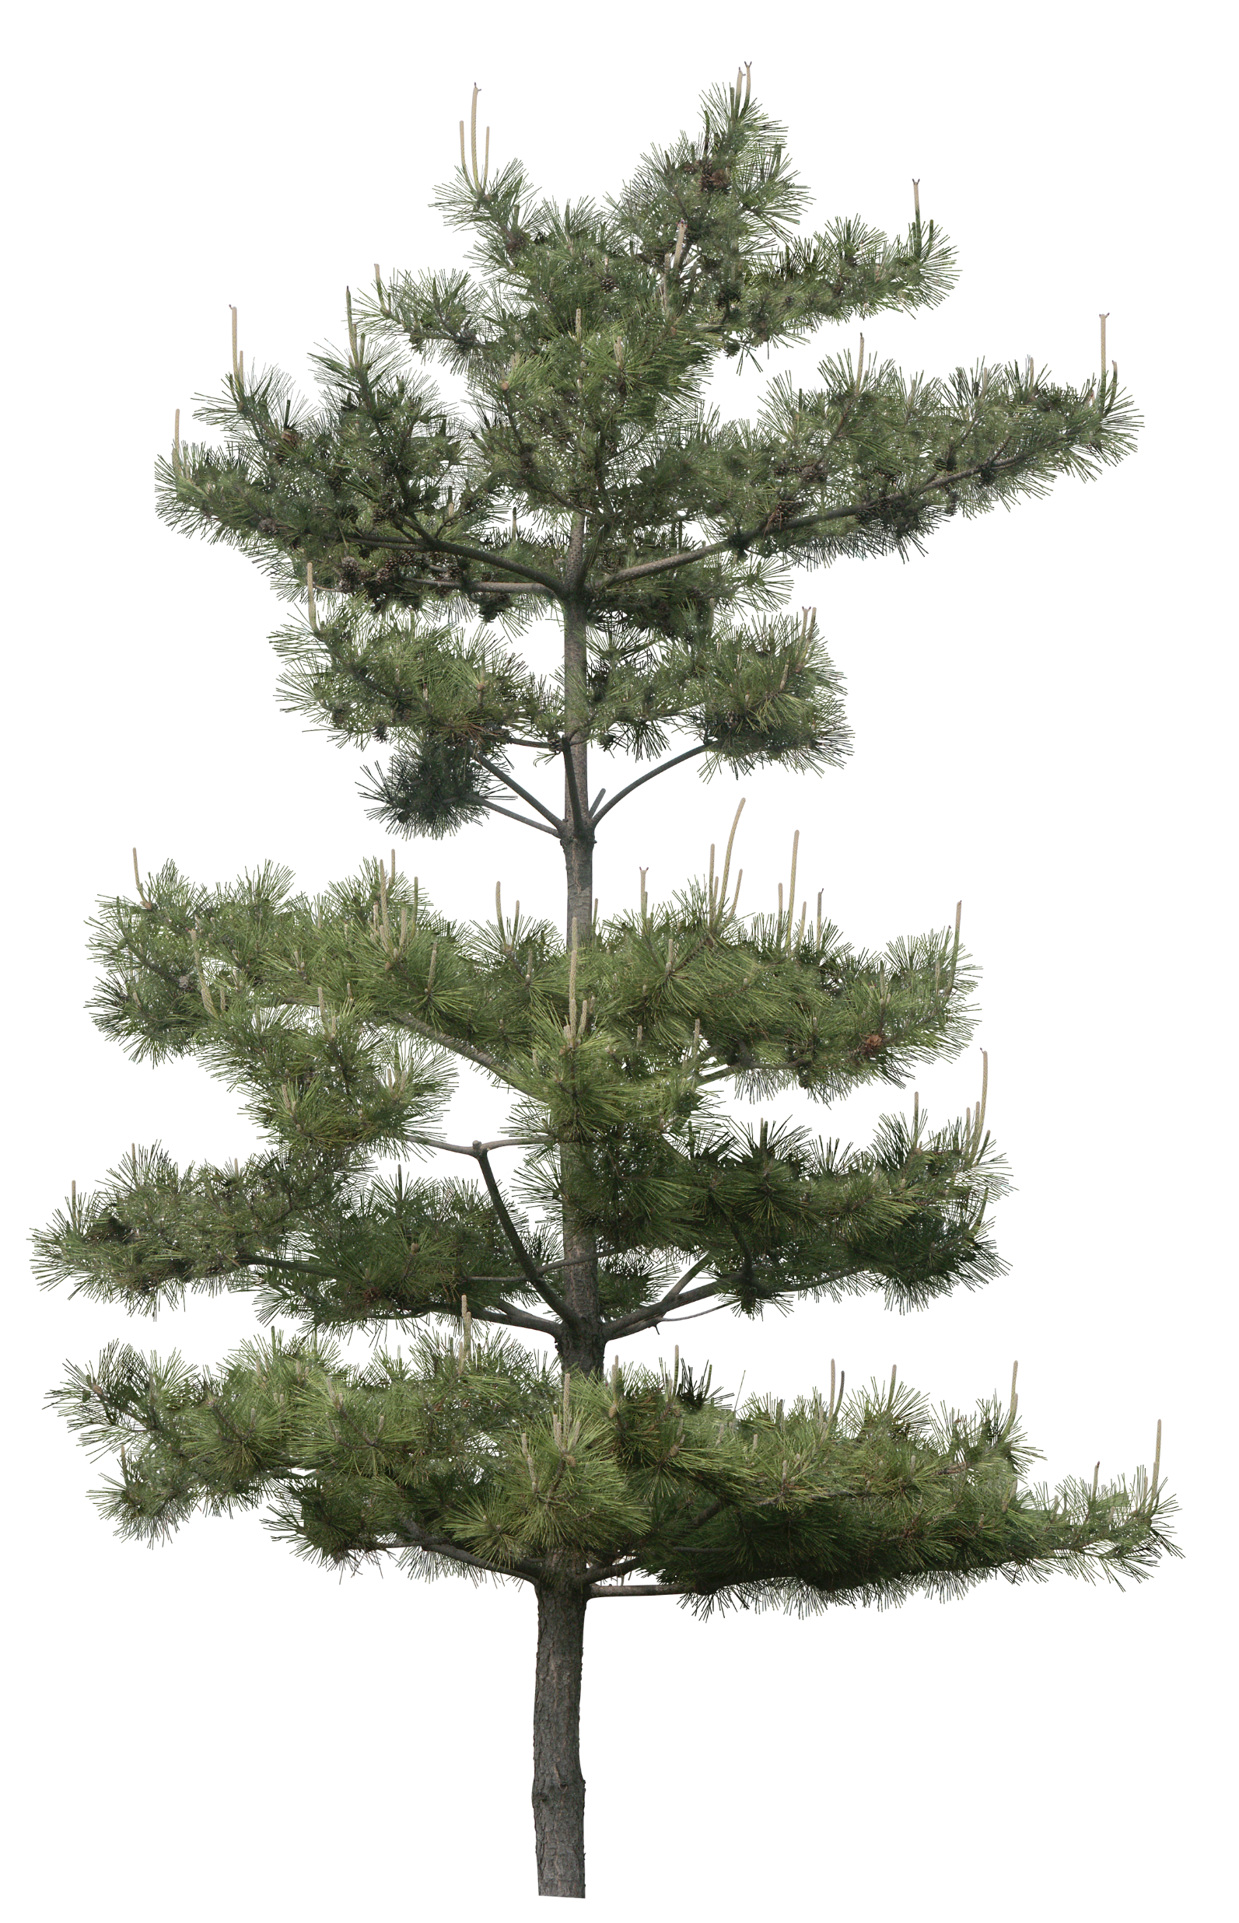
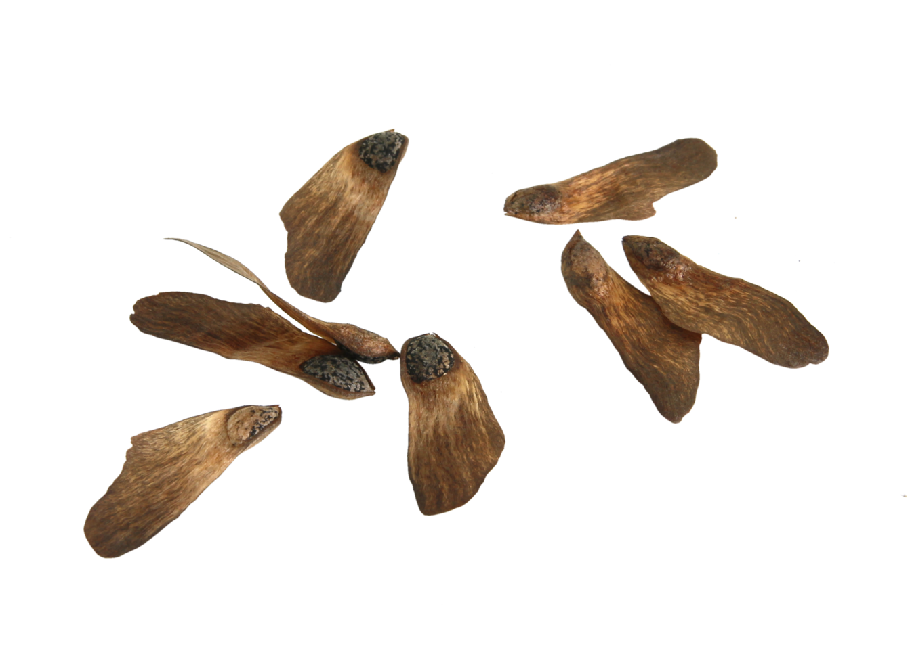
Study design
Origin
Plantation
Regeneration
North Coast
Benmore
Rowens
Benmore
Rowens
Alaska
Skeena River
UKCEH
Notes:
Example: A regen tree from Benmore: mother is from Plantation in Benmore. Grandmother can be from Plantation in Alaska, North Coast or Skeena River.
Question: how rapidly do trees adapt to Scottish conditions?
Seeds that were brought from Origin have already germinated in UK conditions and grown to maturity and successfully reproduced in Plantations = first selection
Seeds that have come from Plantation have naturally germinated in local Scottish conditions = second selection
(Seeds from Regen have germinated in local UKCEH conditions = third selection for those that have not died?)
Treatment: seeds from all three locations = two years in seedling pots outside at UKCEH.
Family = half siblings from same mother tree (e.g., 50 or 10 seedlings)
Hypothesis: trees from regen grow better (taller). What about their resilience to disease, specifically Dothistroma? Have already coped with exposure to DNB in Scottish conditions and lived through exposure to produce seeds. Probably also most likely to stay green throughout bioassay.

Slide 3
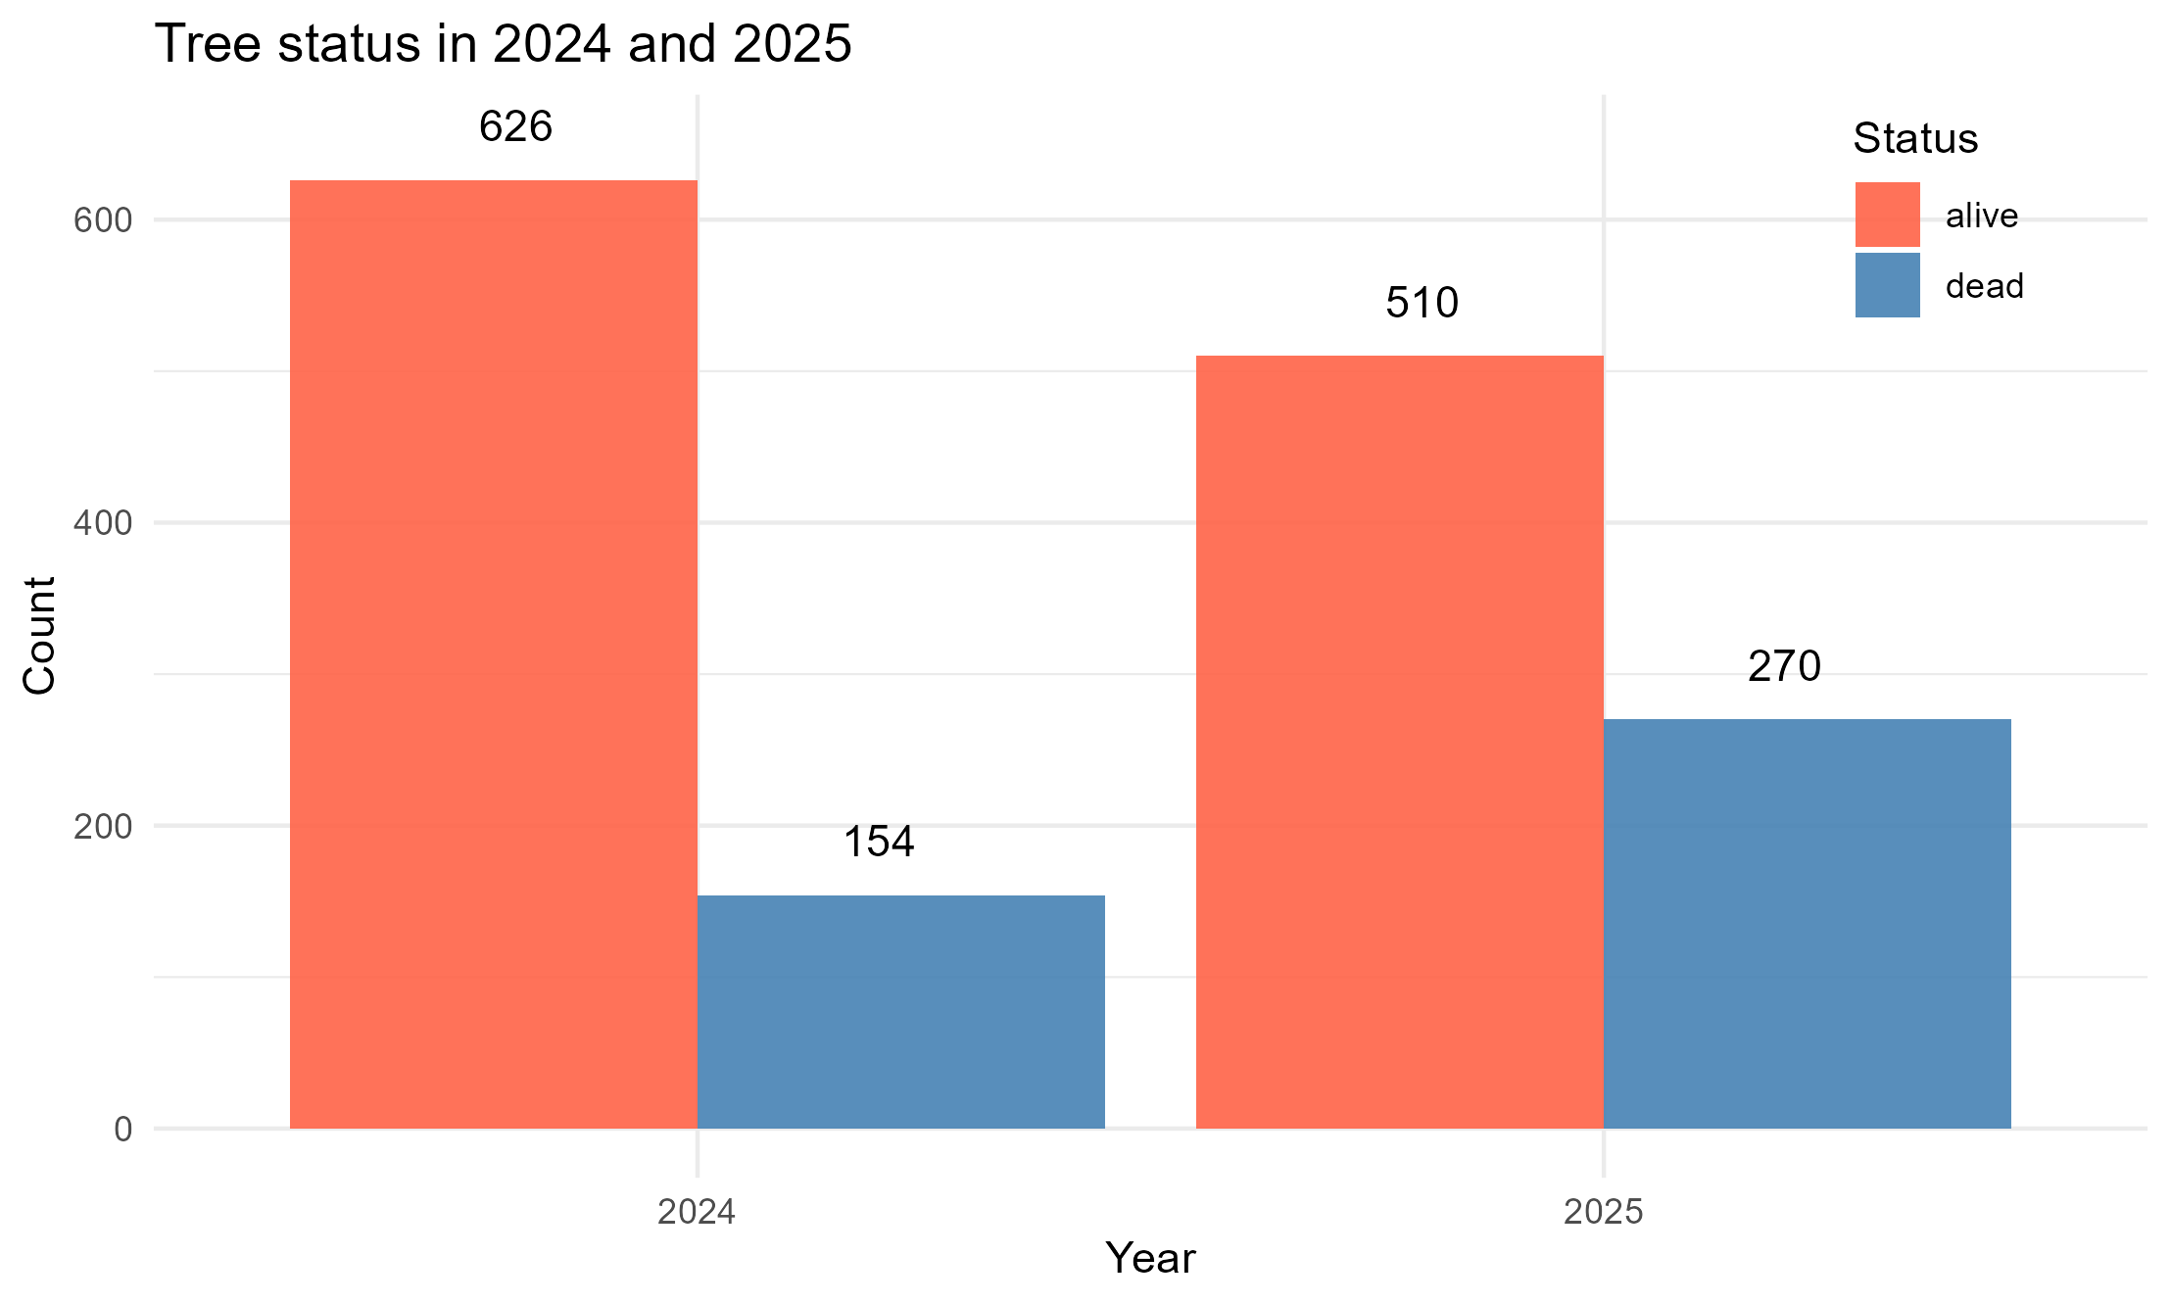
Tree status – 2024-2025
n = 780
-116

Slide 4
How many families in each Cohort & provenance?

Slide 5
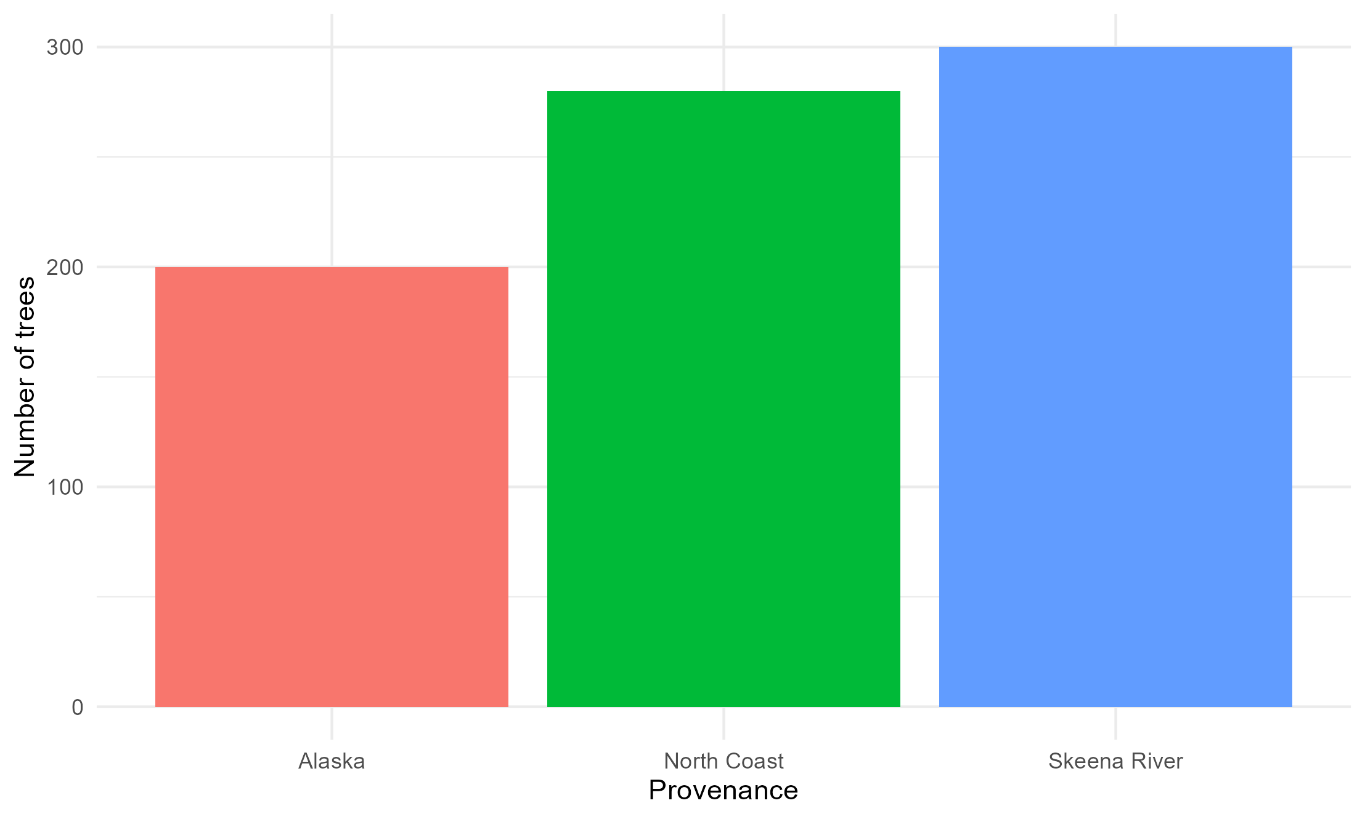
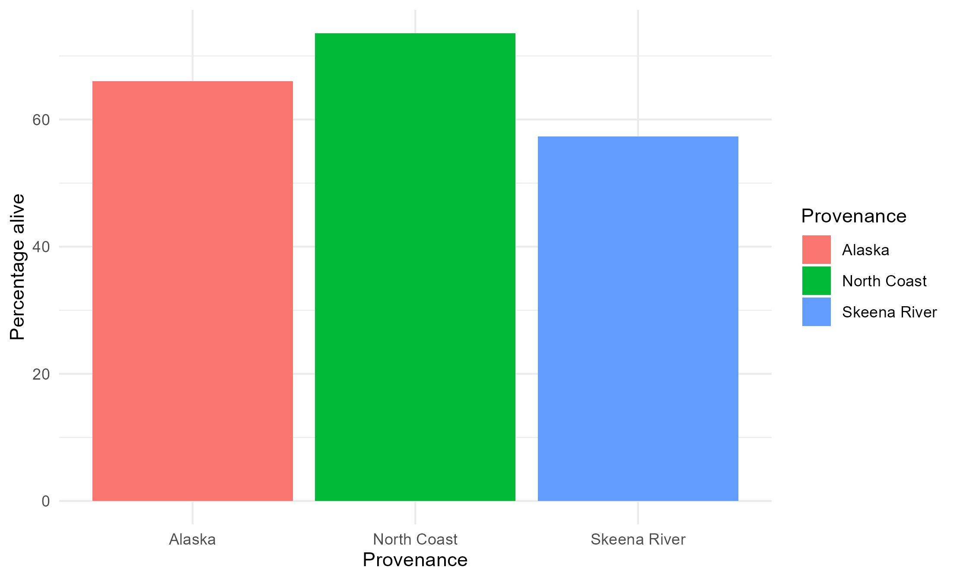
Provenance distribution & status

Slide 6
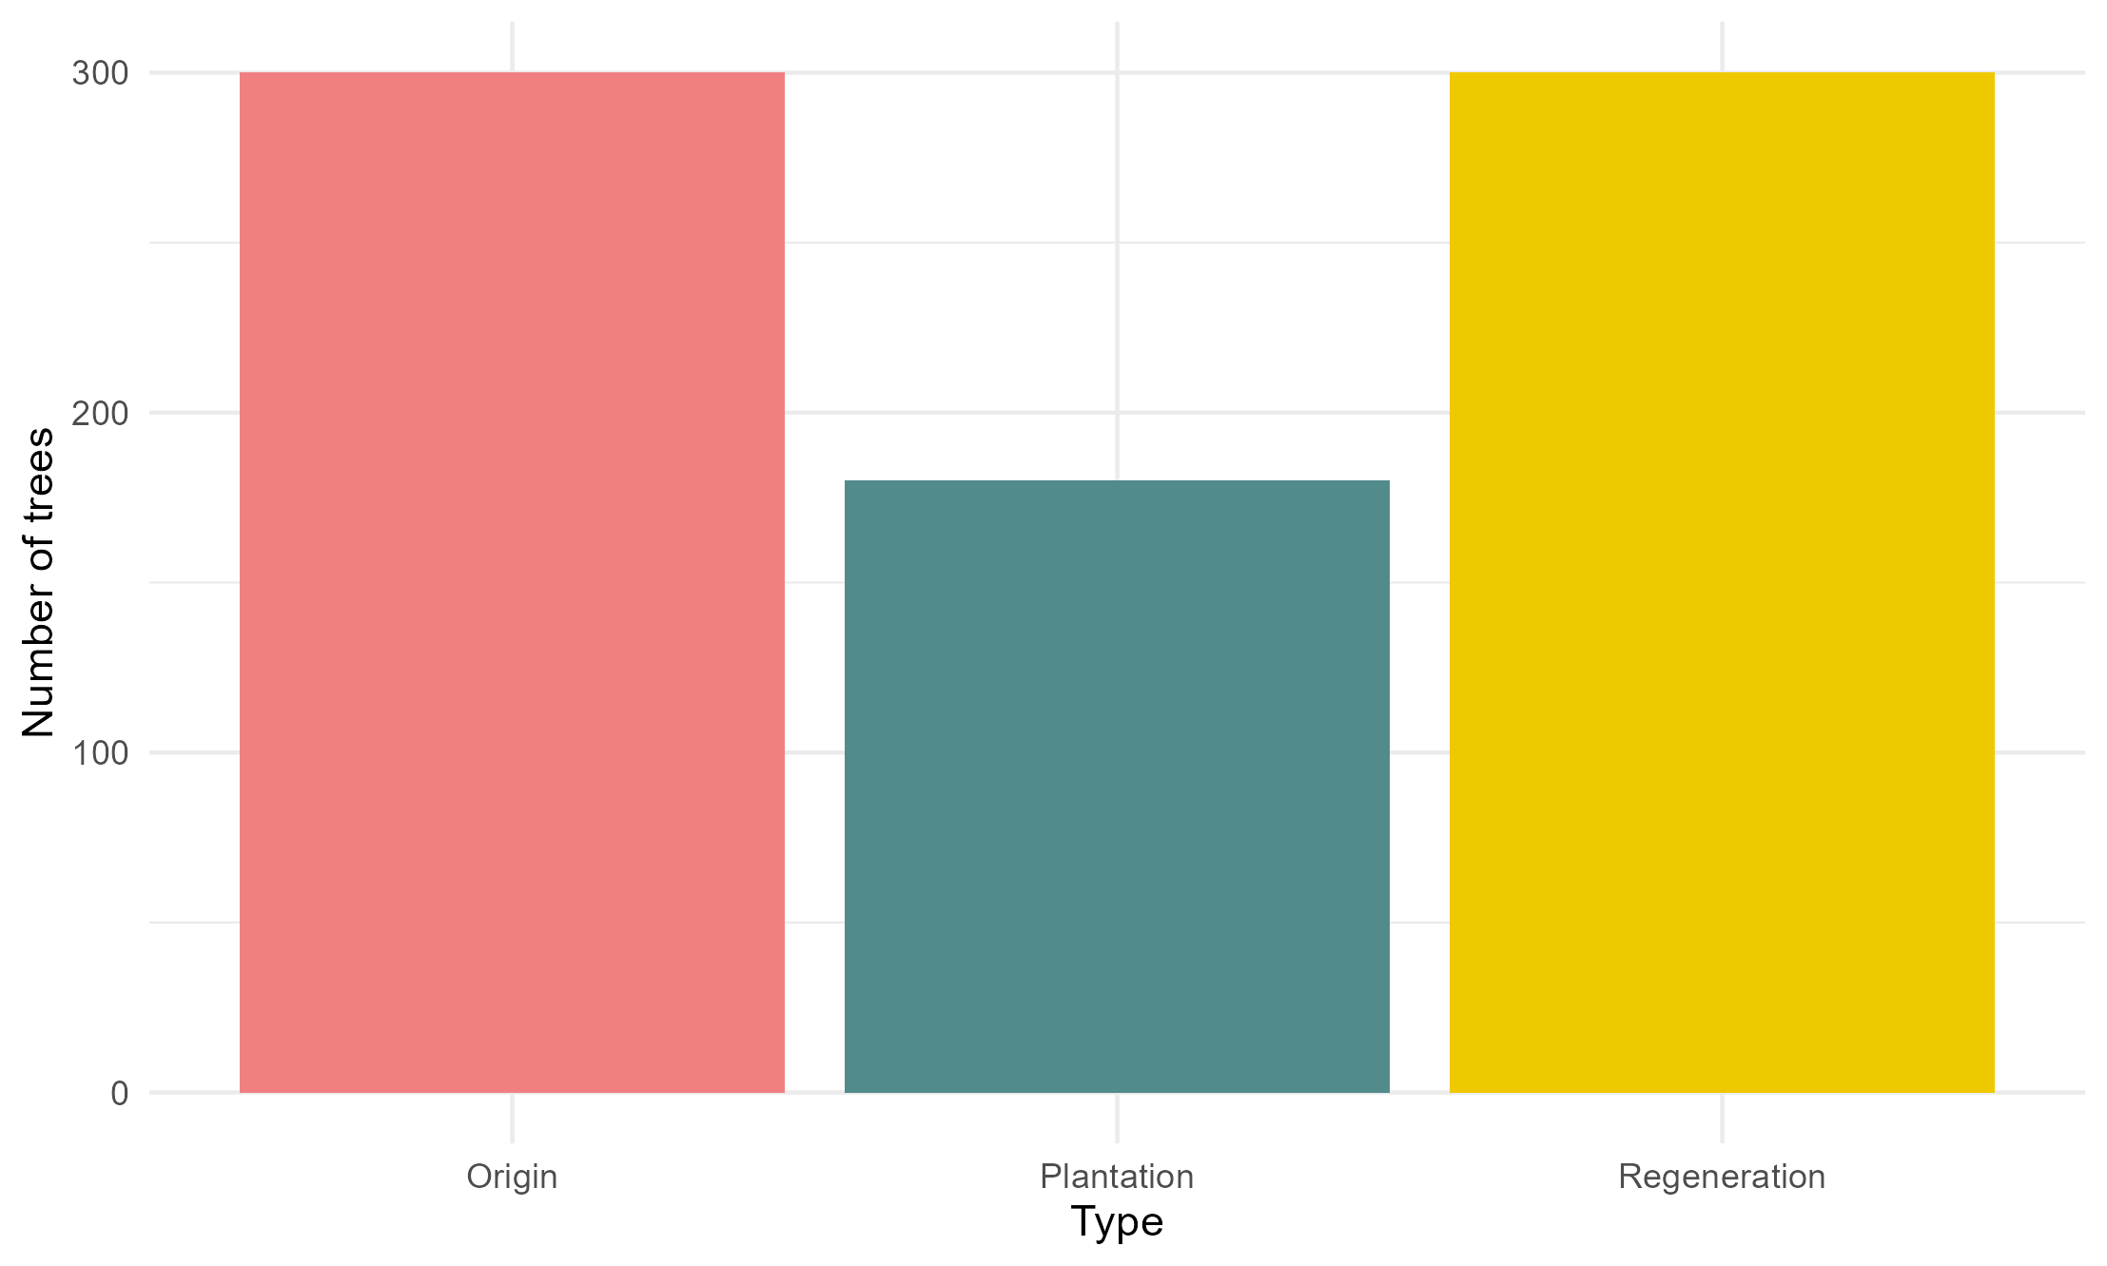
Cohort distribution

Slide 7
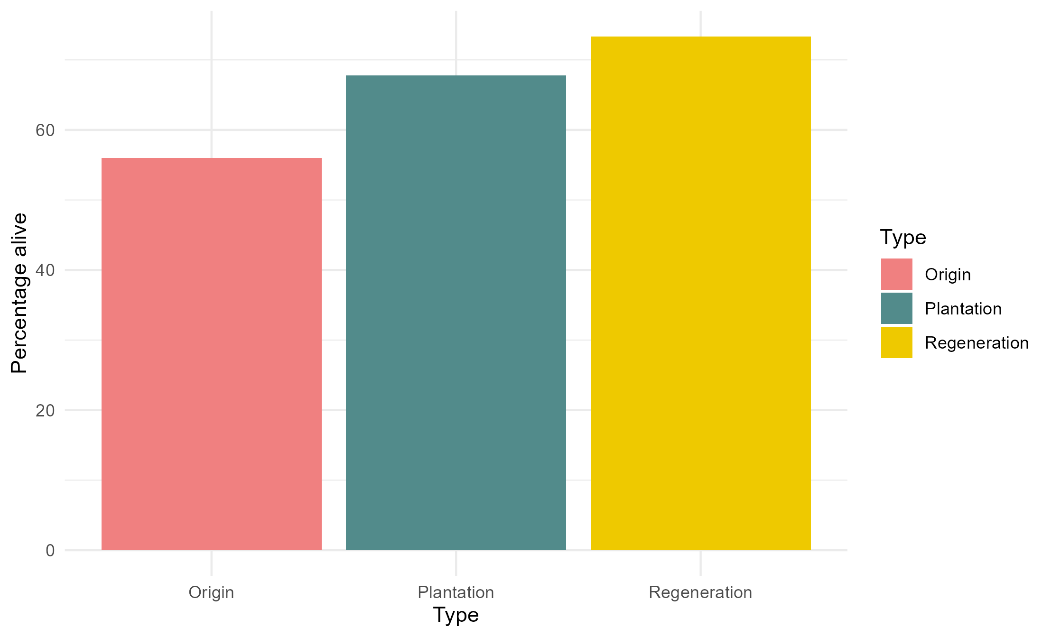
Status – by Cohort

Slide 8
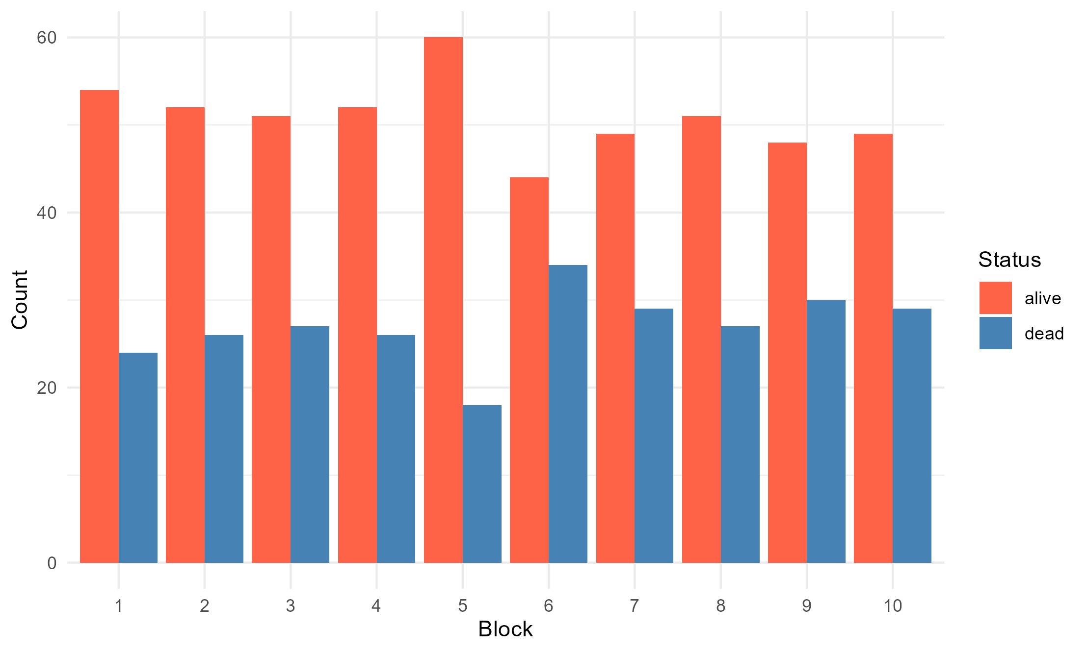
Status – by Block

Slide 9
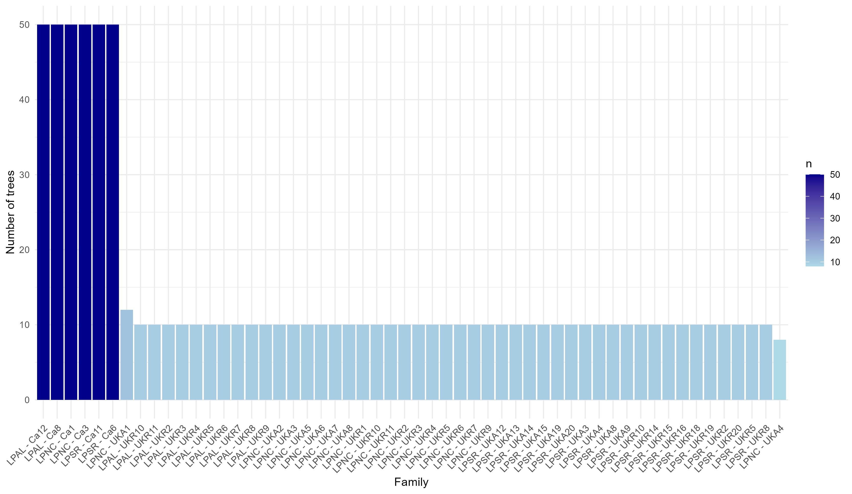
Family distribution

Slide 10
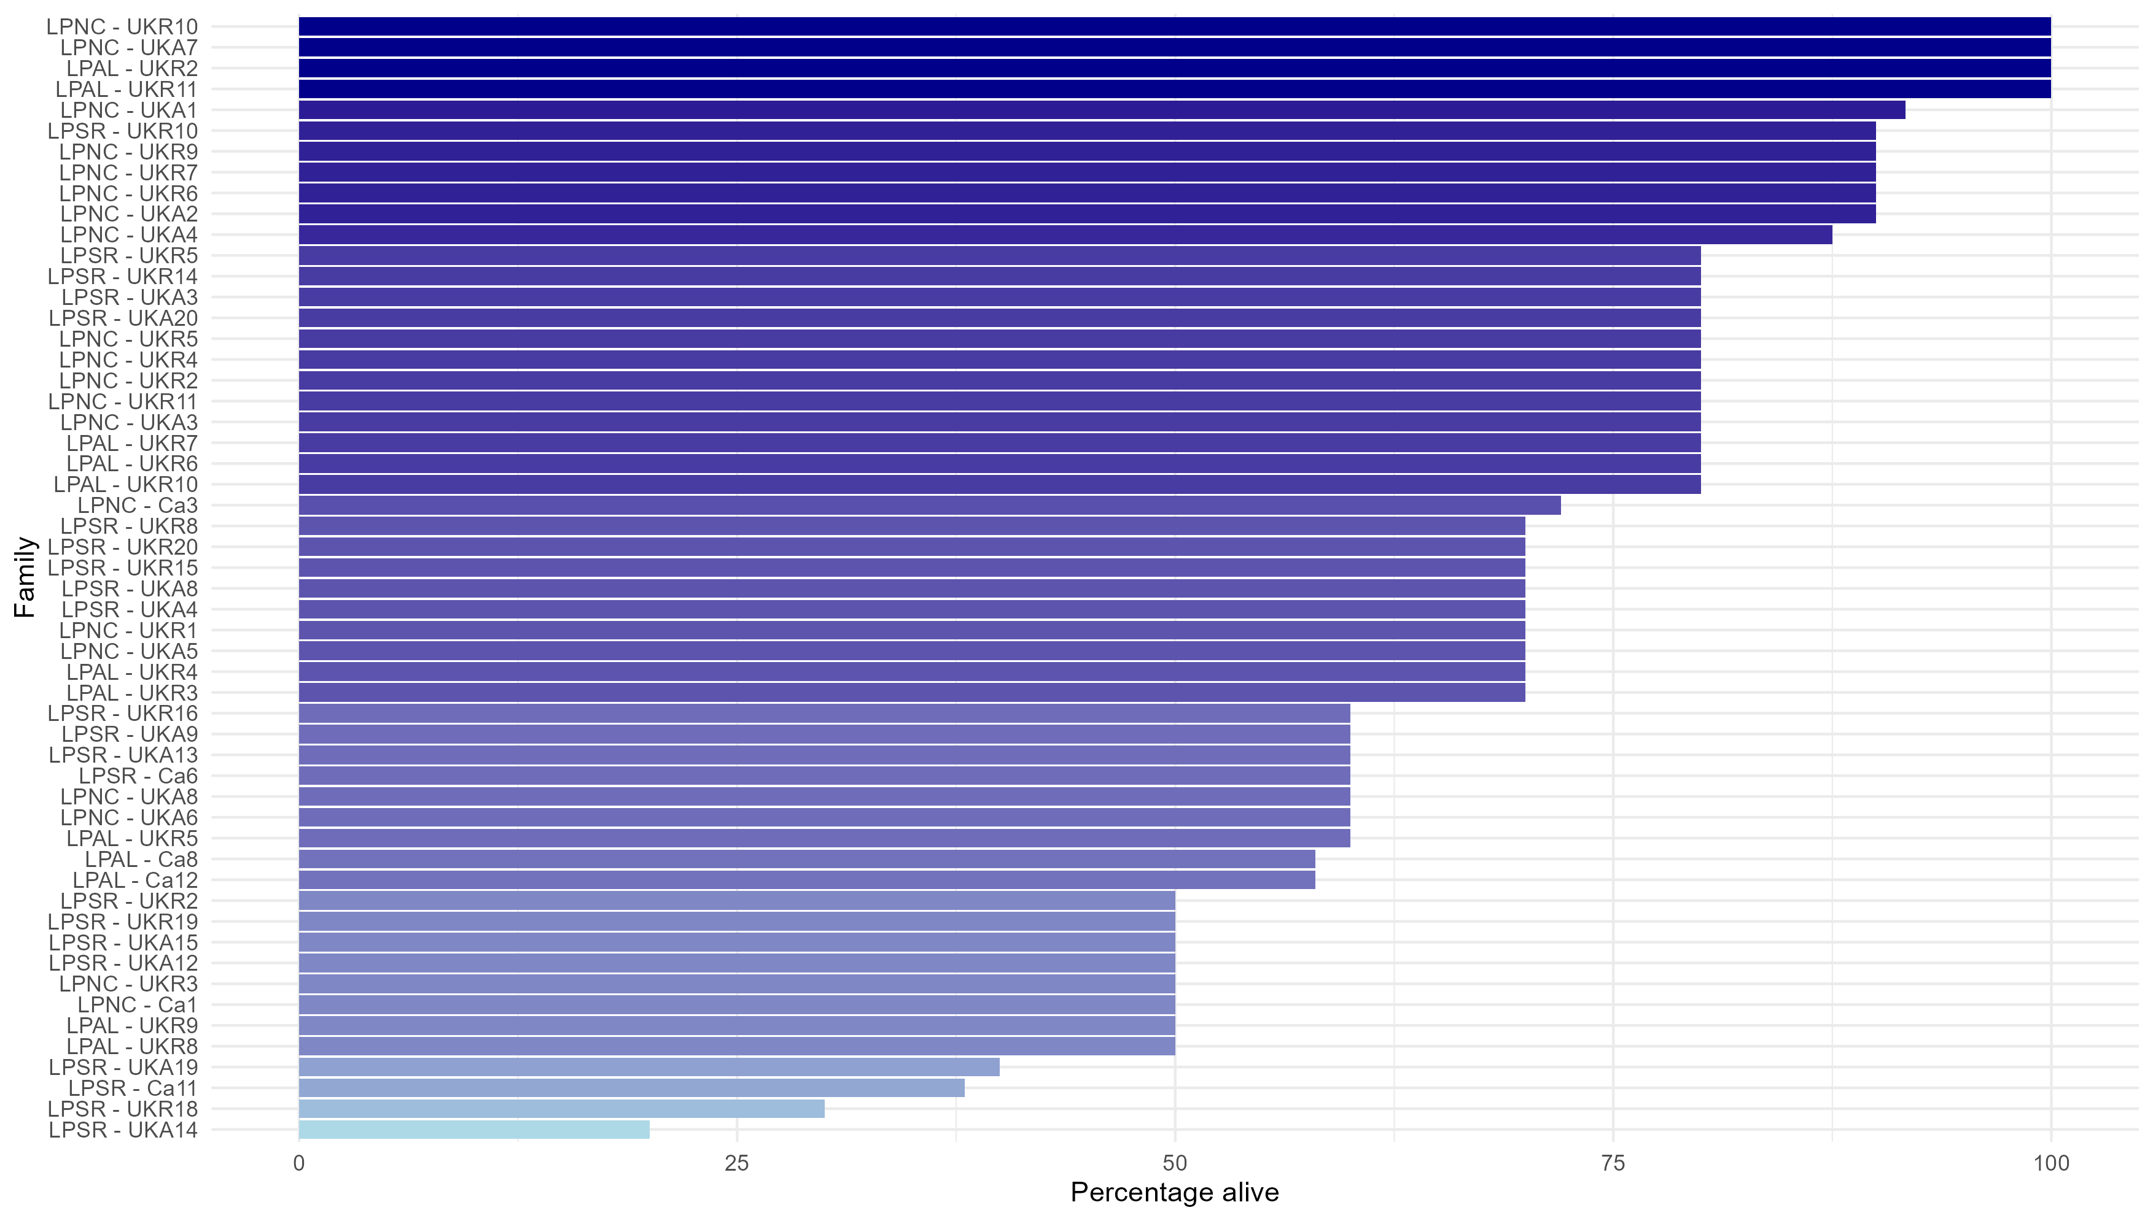
Status – by Family
Arranged by percent alive -> families have different numbers of initial trees but same percentage alive

Slide 11
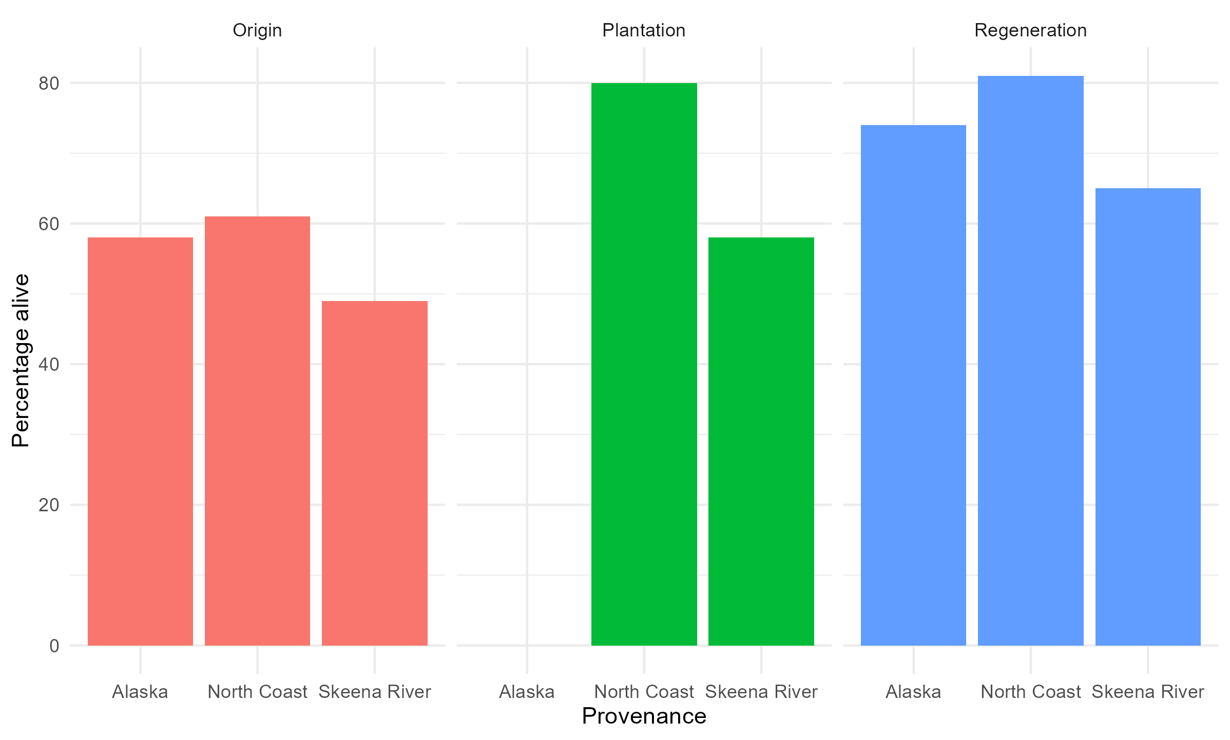
Interaction – Provenance and Cohort
GLMM model says Provenance has strongest effect (14% of variation) and Cohort (cohort) also strong effect (11%)
Family = random effect

Slide 12
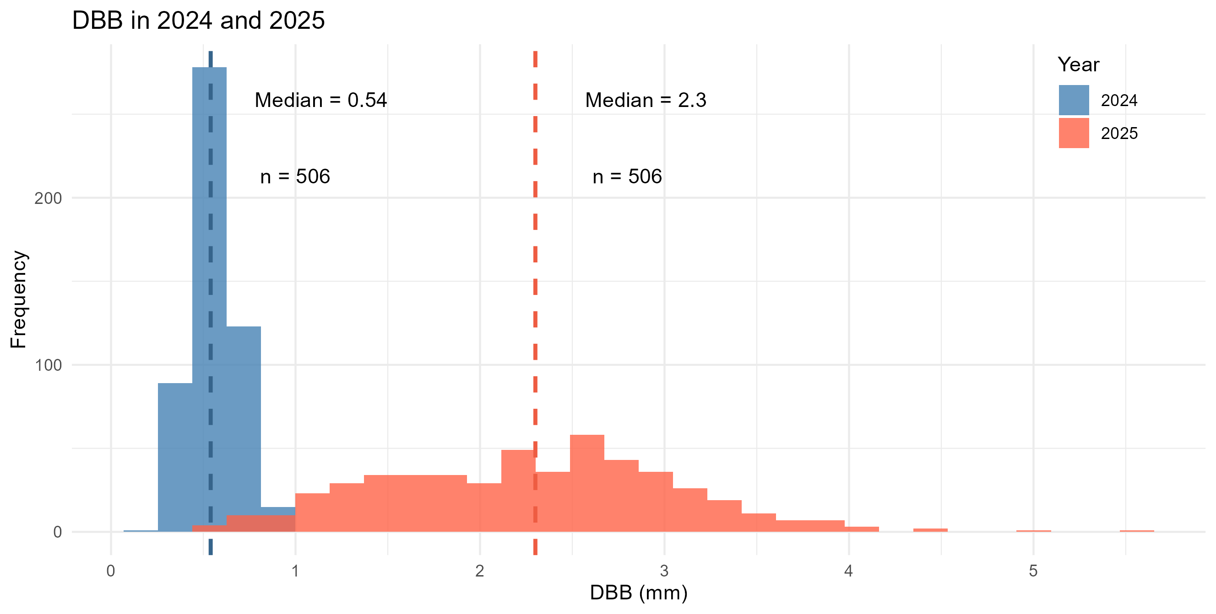
DBB
506 trees that are alive at both timepoints have DBB measurements

Slide 13
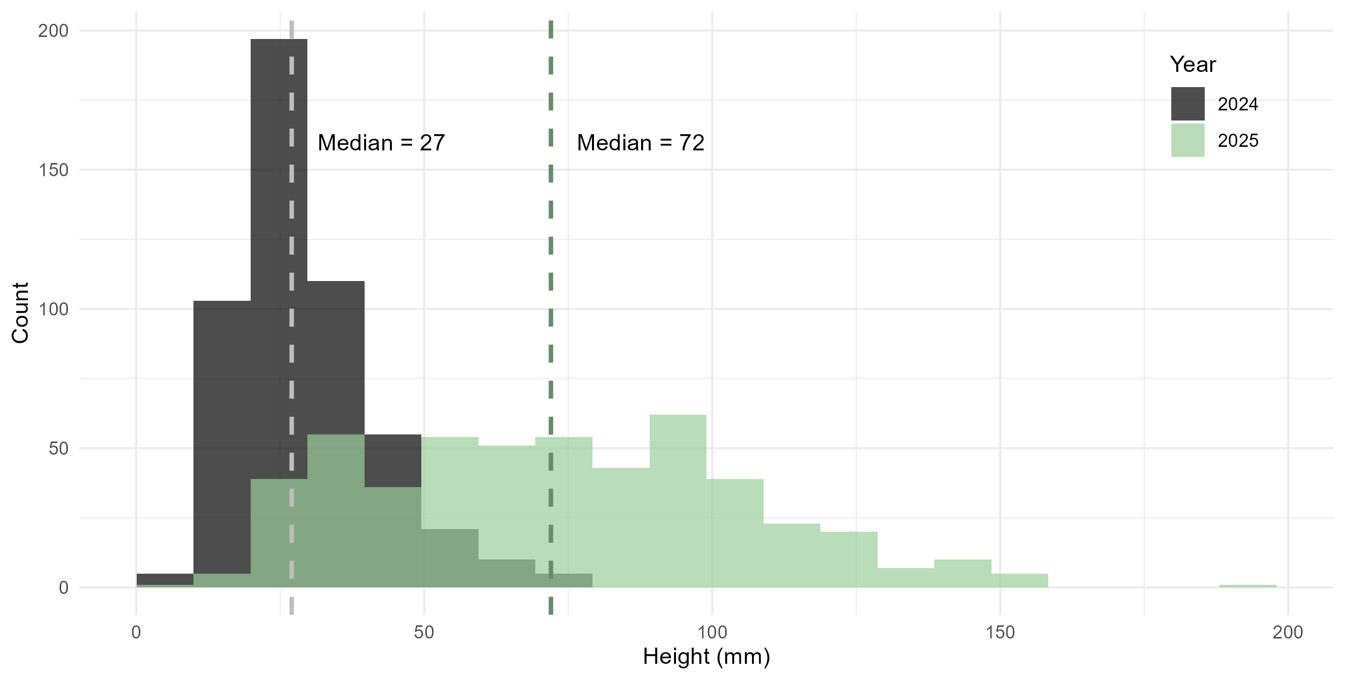
Height
506 trees that are alive at both timepoints have height measurements
1 tree is alive at both and has DBB but not height

Slide 14
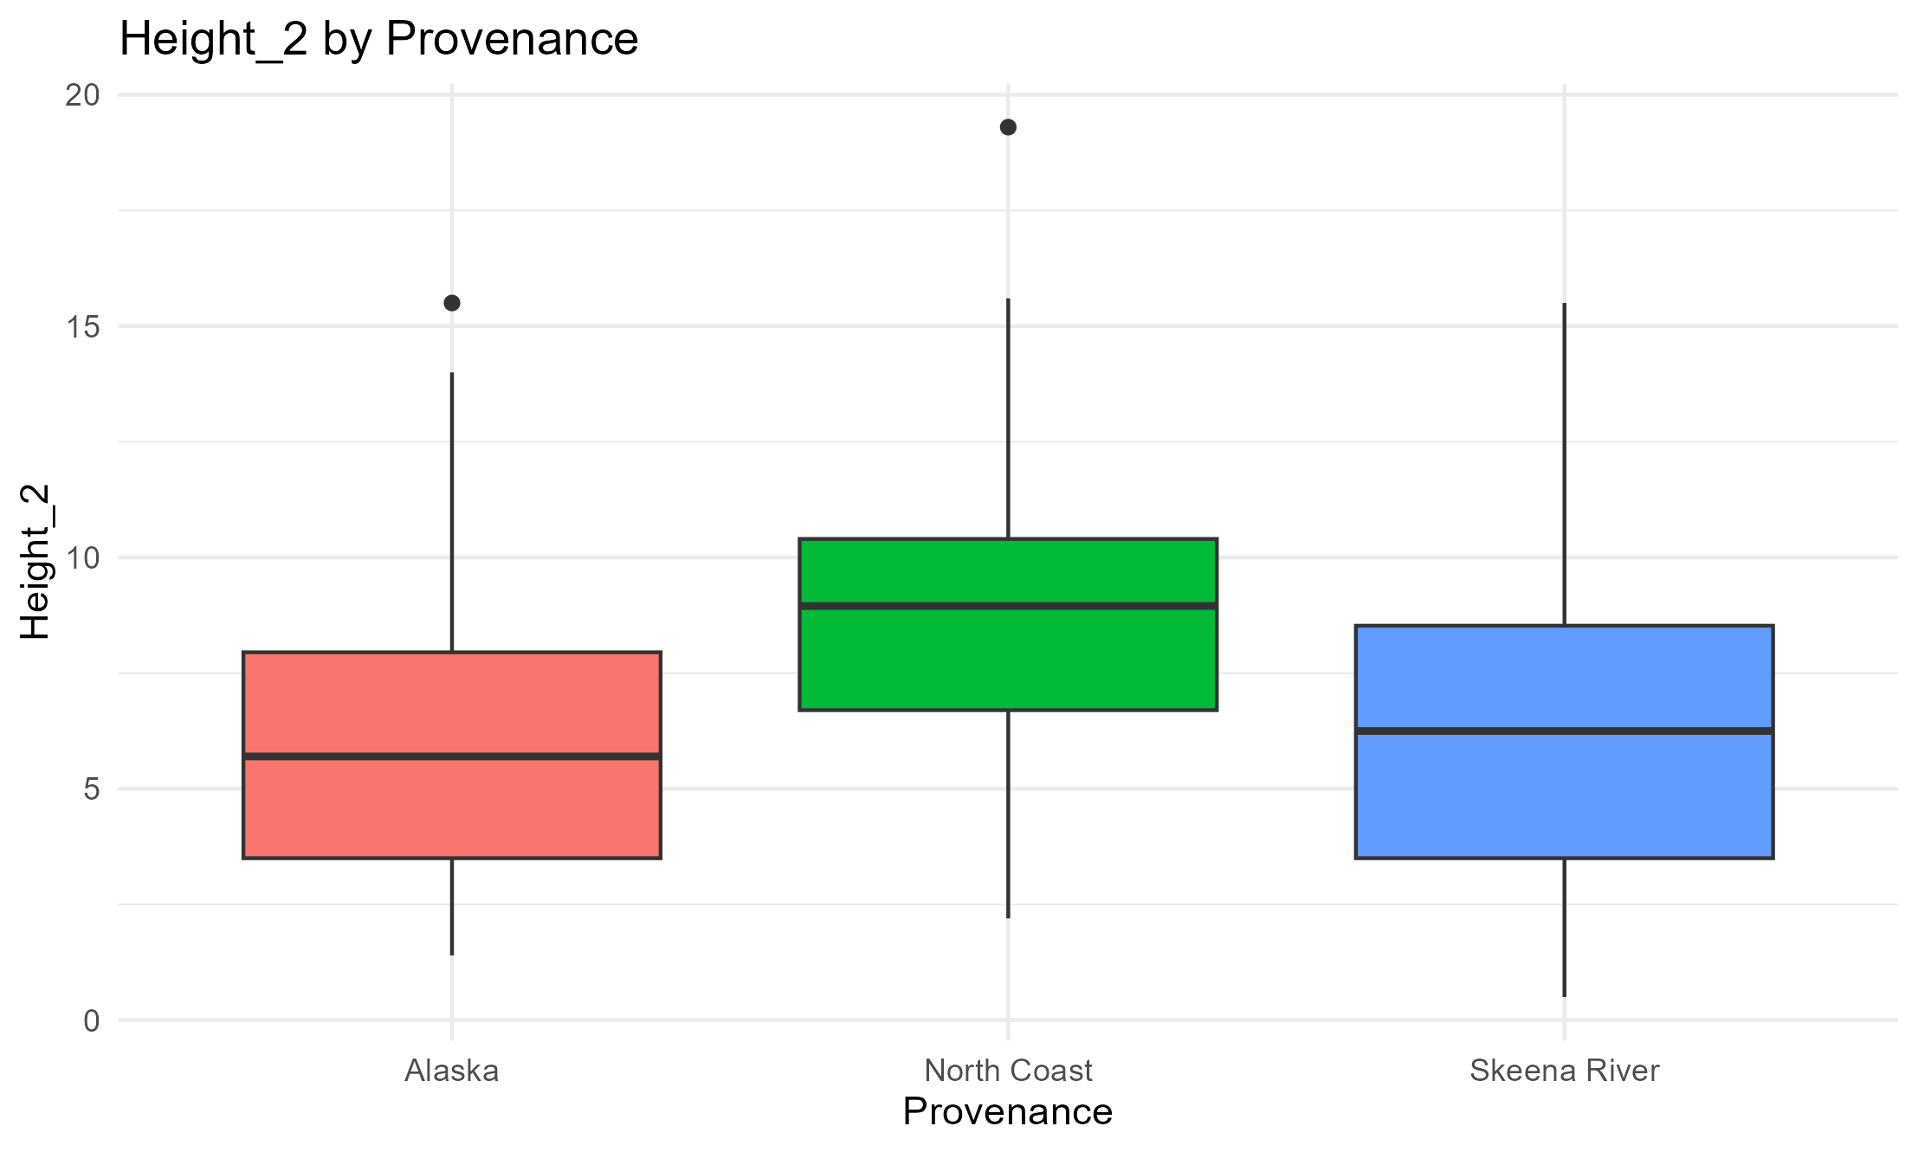
Height – by Provenance
*
*

Slide 15
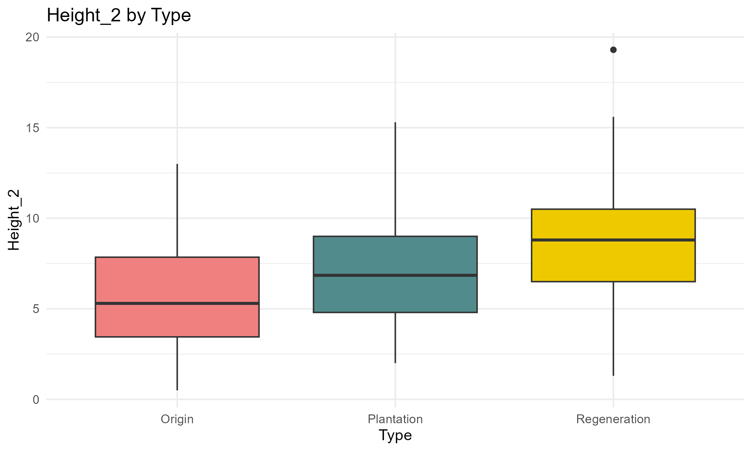
Height – by Cohort
*
*
*

Slide 16
Budset & Budburst
Date of planting: 20-23/6/2023
Budset period: 11/9/2023 – 17/5/2024
Budburst period: 2/2/2024 – 22/5/2024
Sample sizes:
Budset: 549 trees
Budburst: 575 trees
(Maybe 26 didn’t have noticeable buds?)
Budset & Budburst: 529 trees have data (~85%)

Slide 17
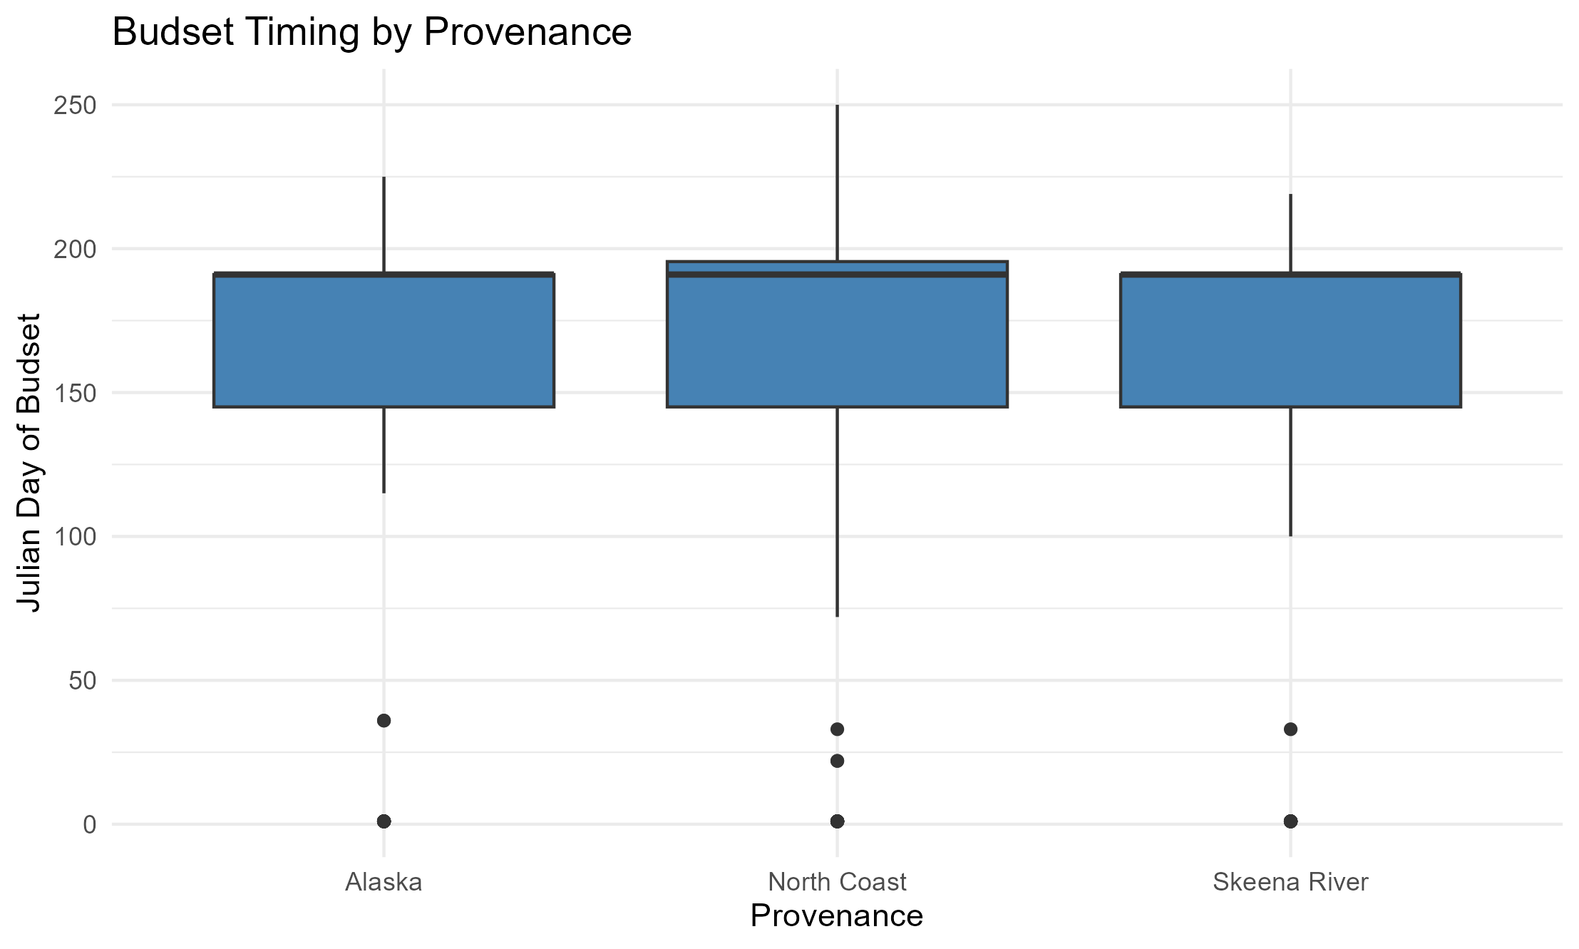
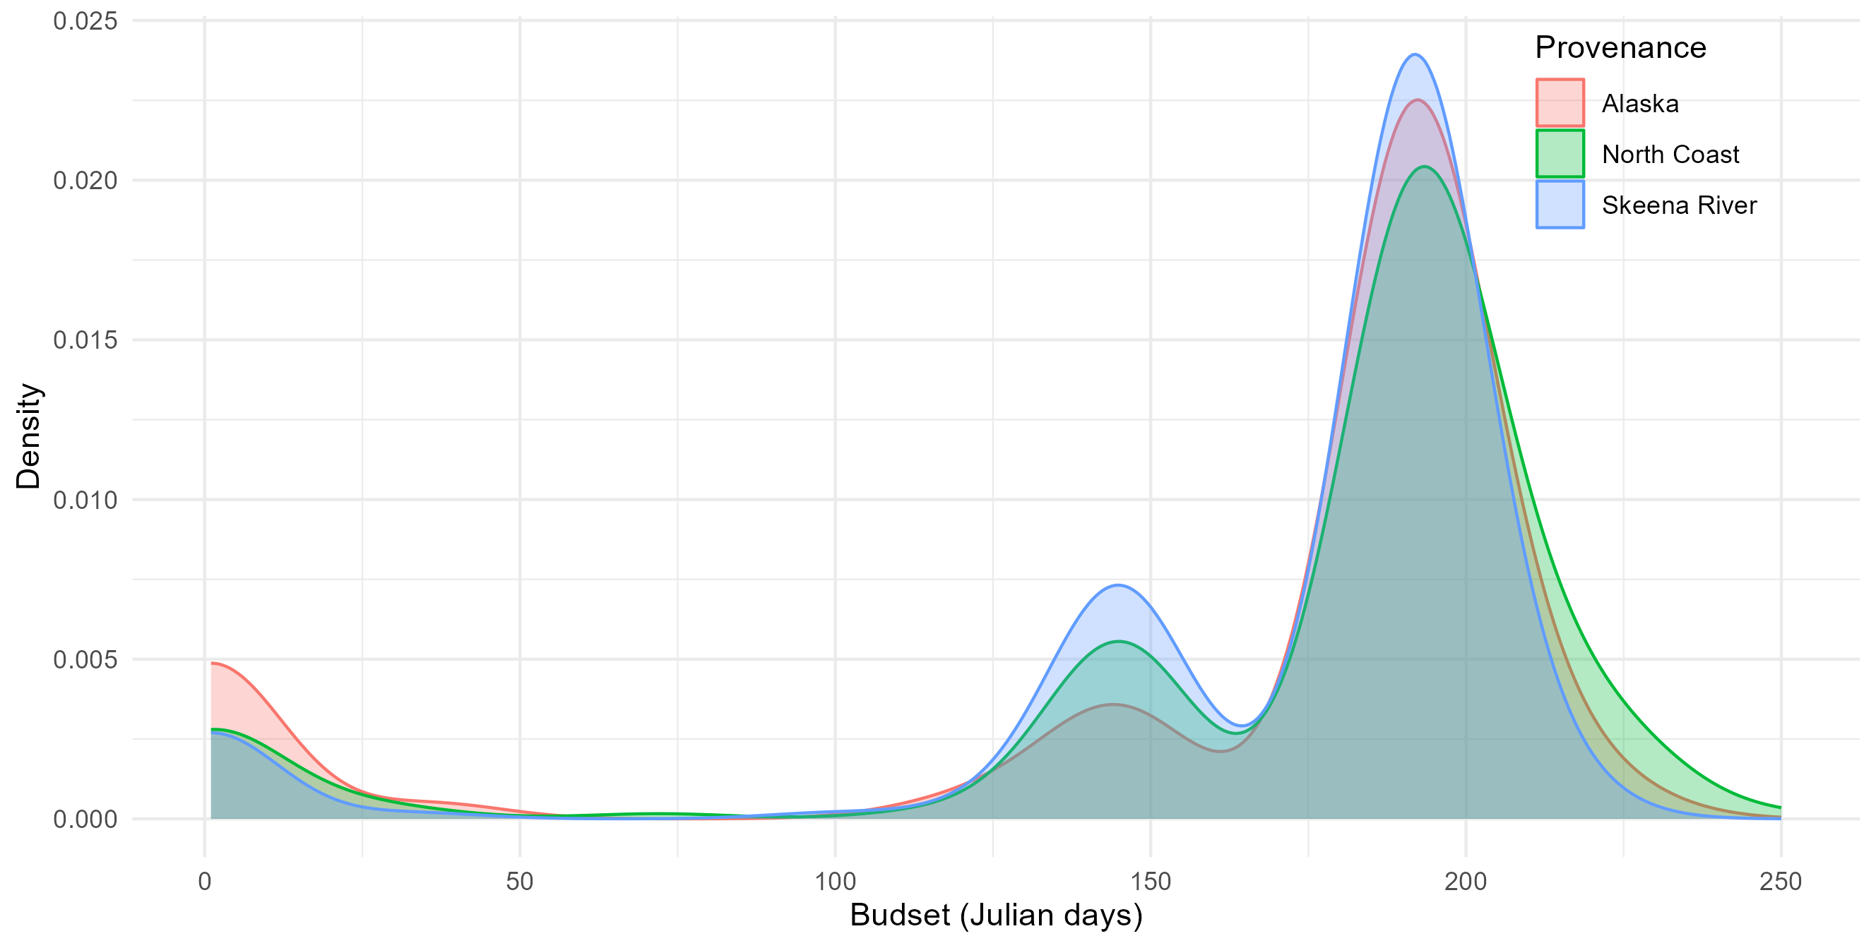
Budset – by provenance
0.042
Even distribution between provenances
Origin date = 10/09/2023
Notes:
North coast n=50

Slide 18
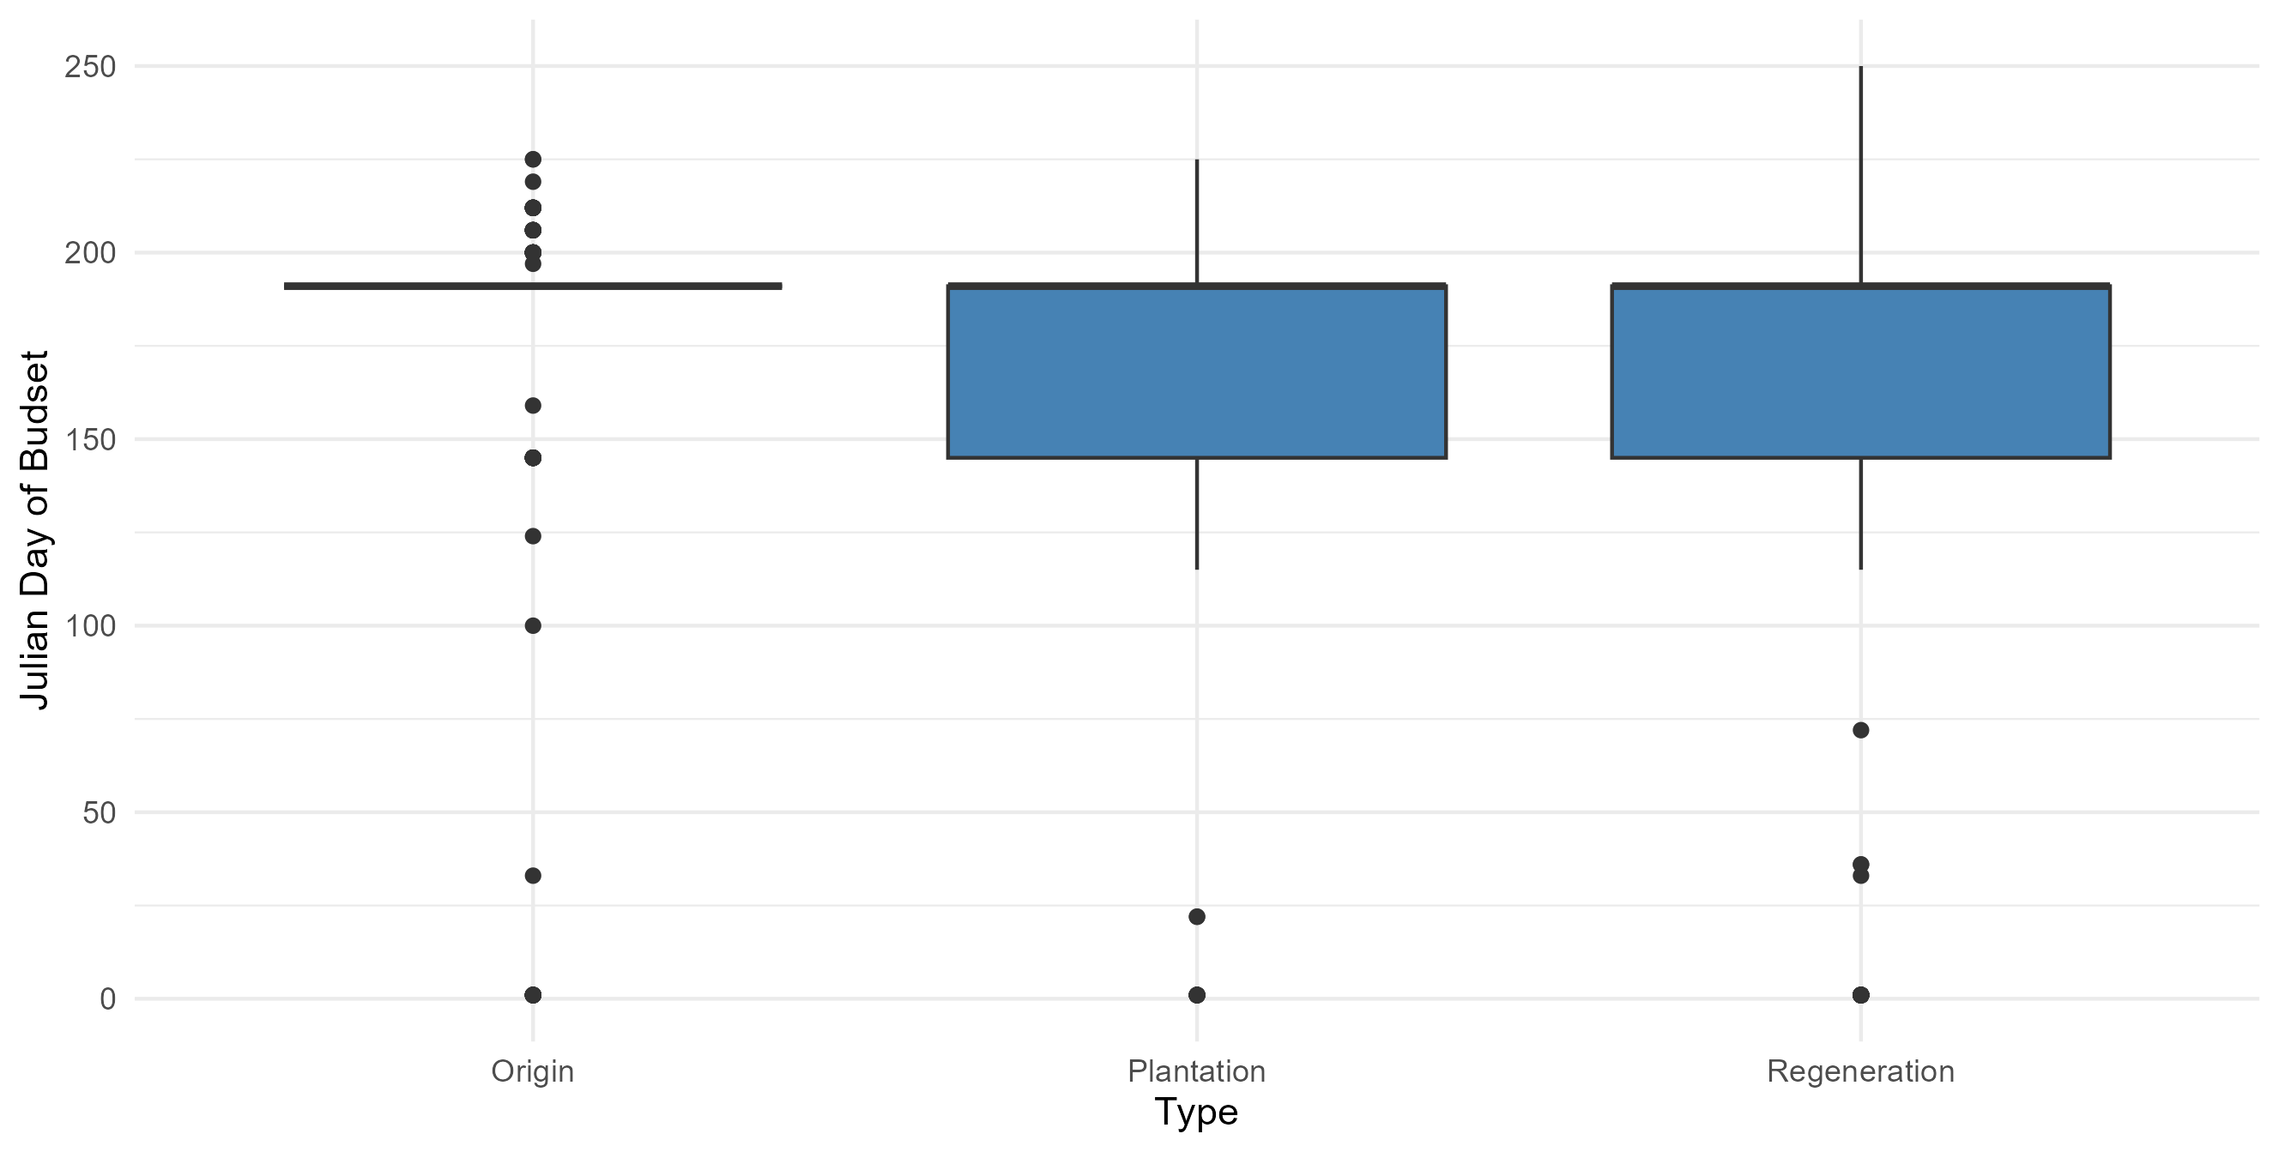
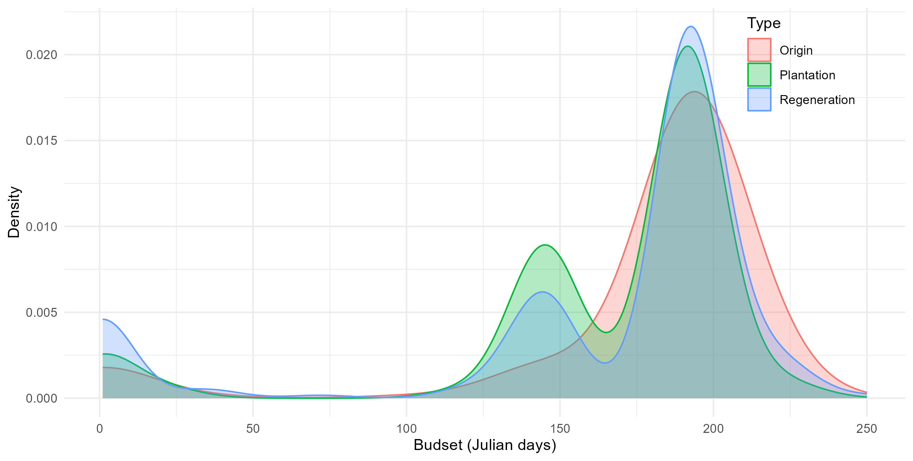
Budset – by Cohort
*
*

Slide 19
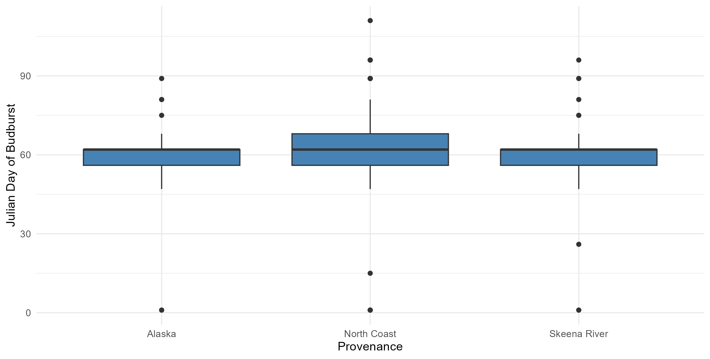
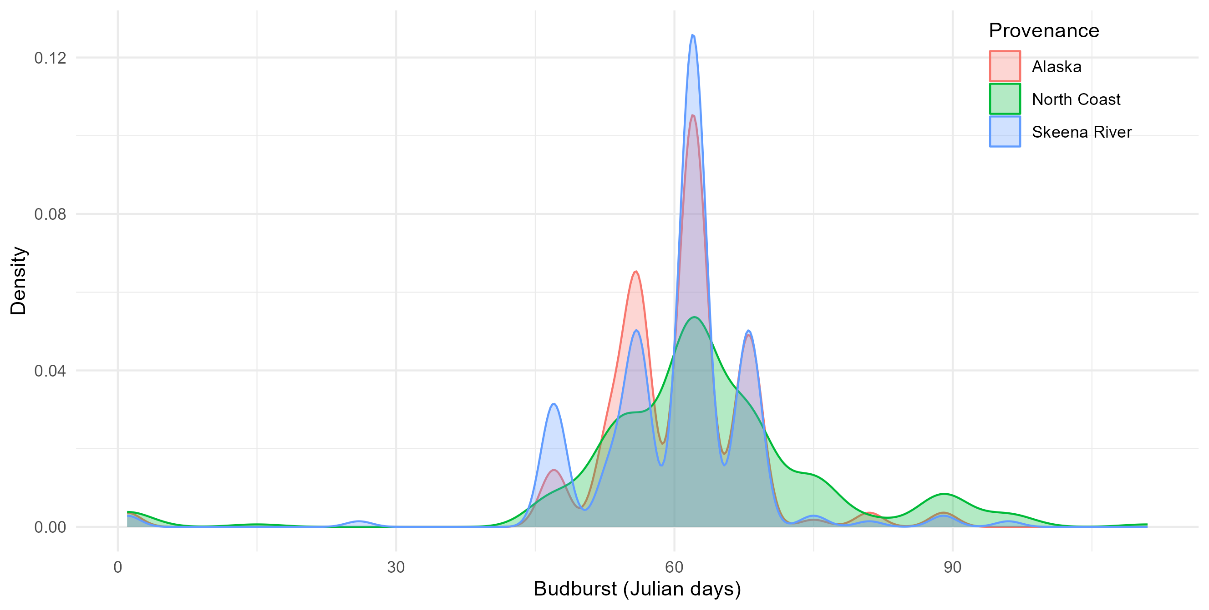
Budburst – by Provenance
Day 0 = 01/02/2024
0.013
0.01

Slide 20
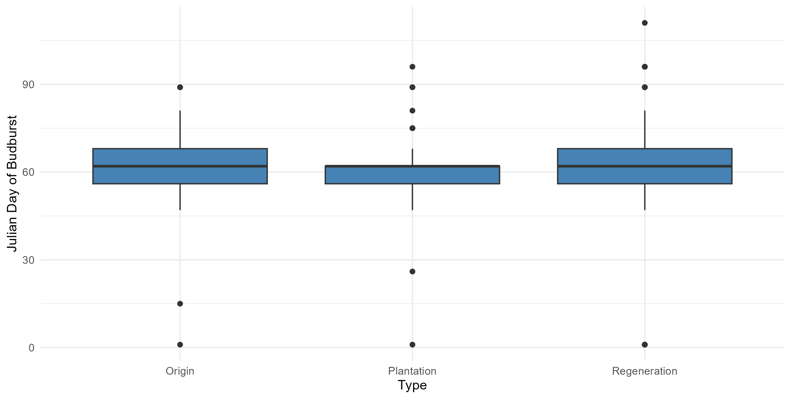
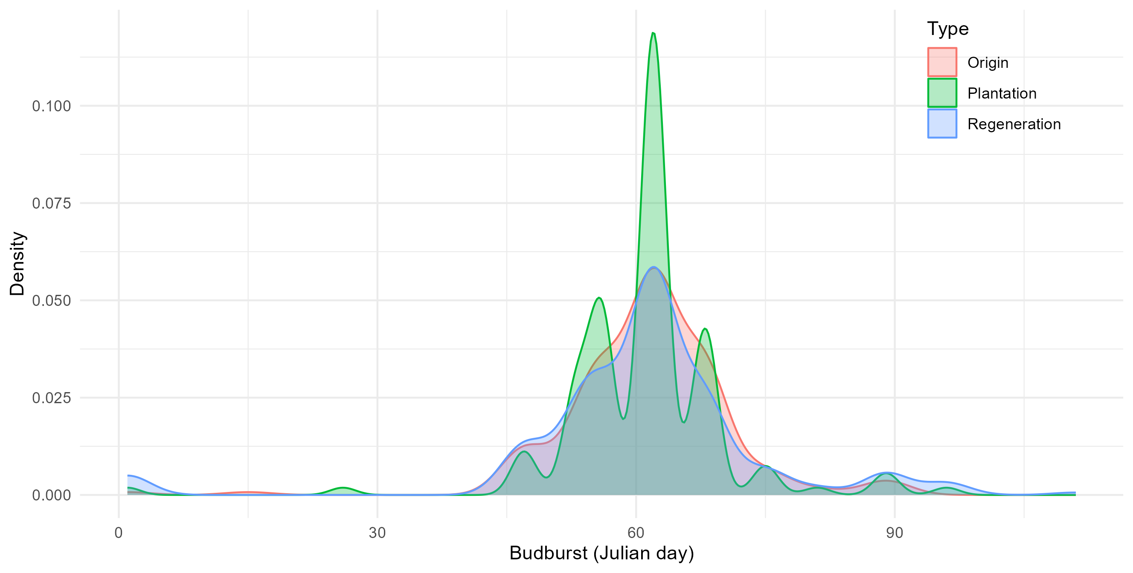
Budburst – by Cohort

Slide 21
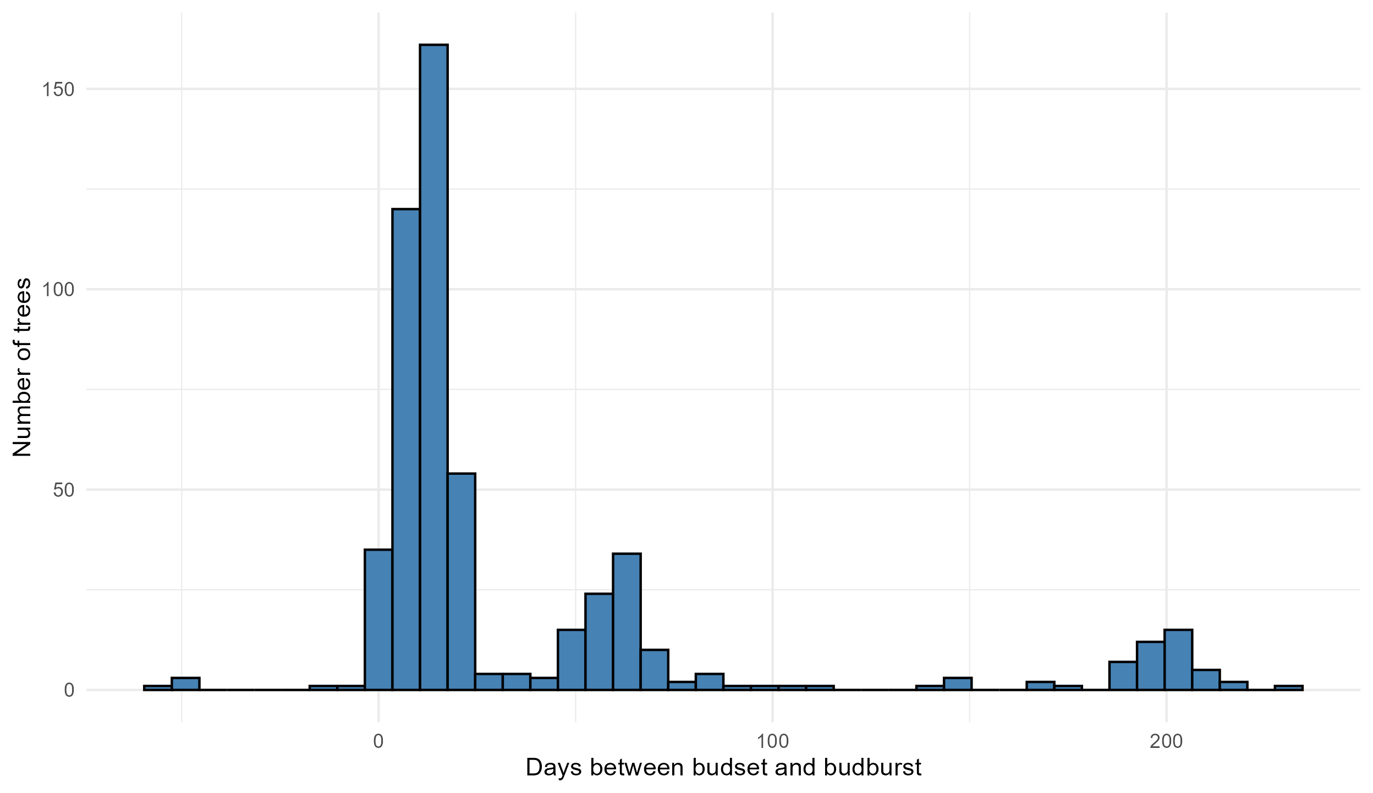
BS & BB offset
6 trees with budset after budburst
(no budset recorded, then budset & budburst simultaneously, then "second" budset afterwards??)

Slide 22
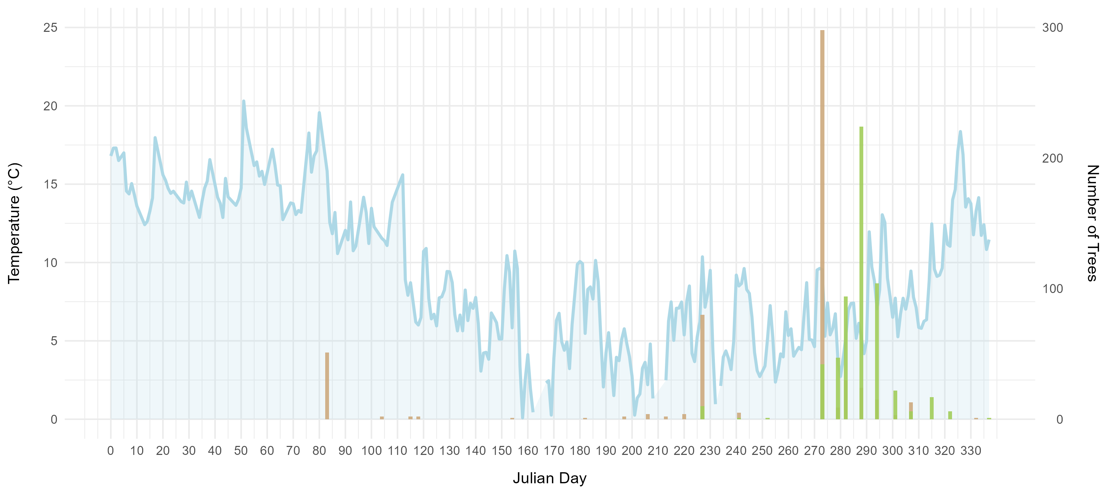
BS & BB data with temperature

Slide 23
Cumulative BS/BB curve (per provenance/Cohort)

Slide 24
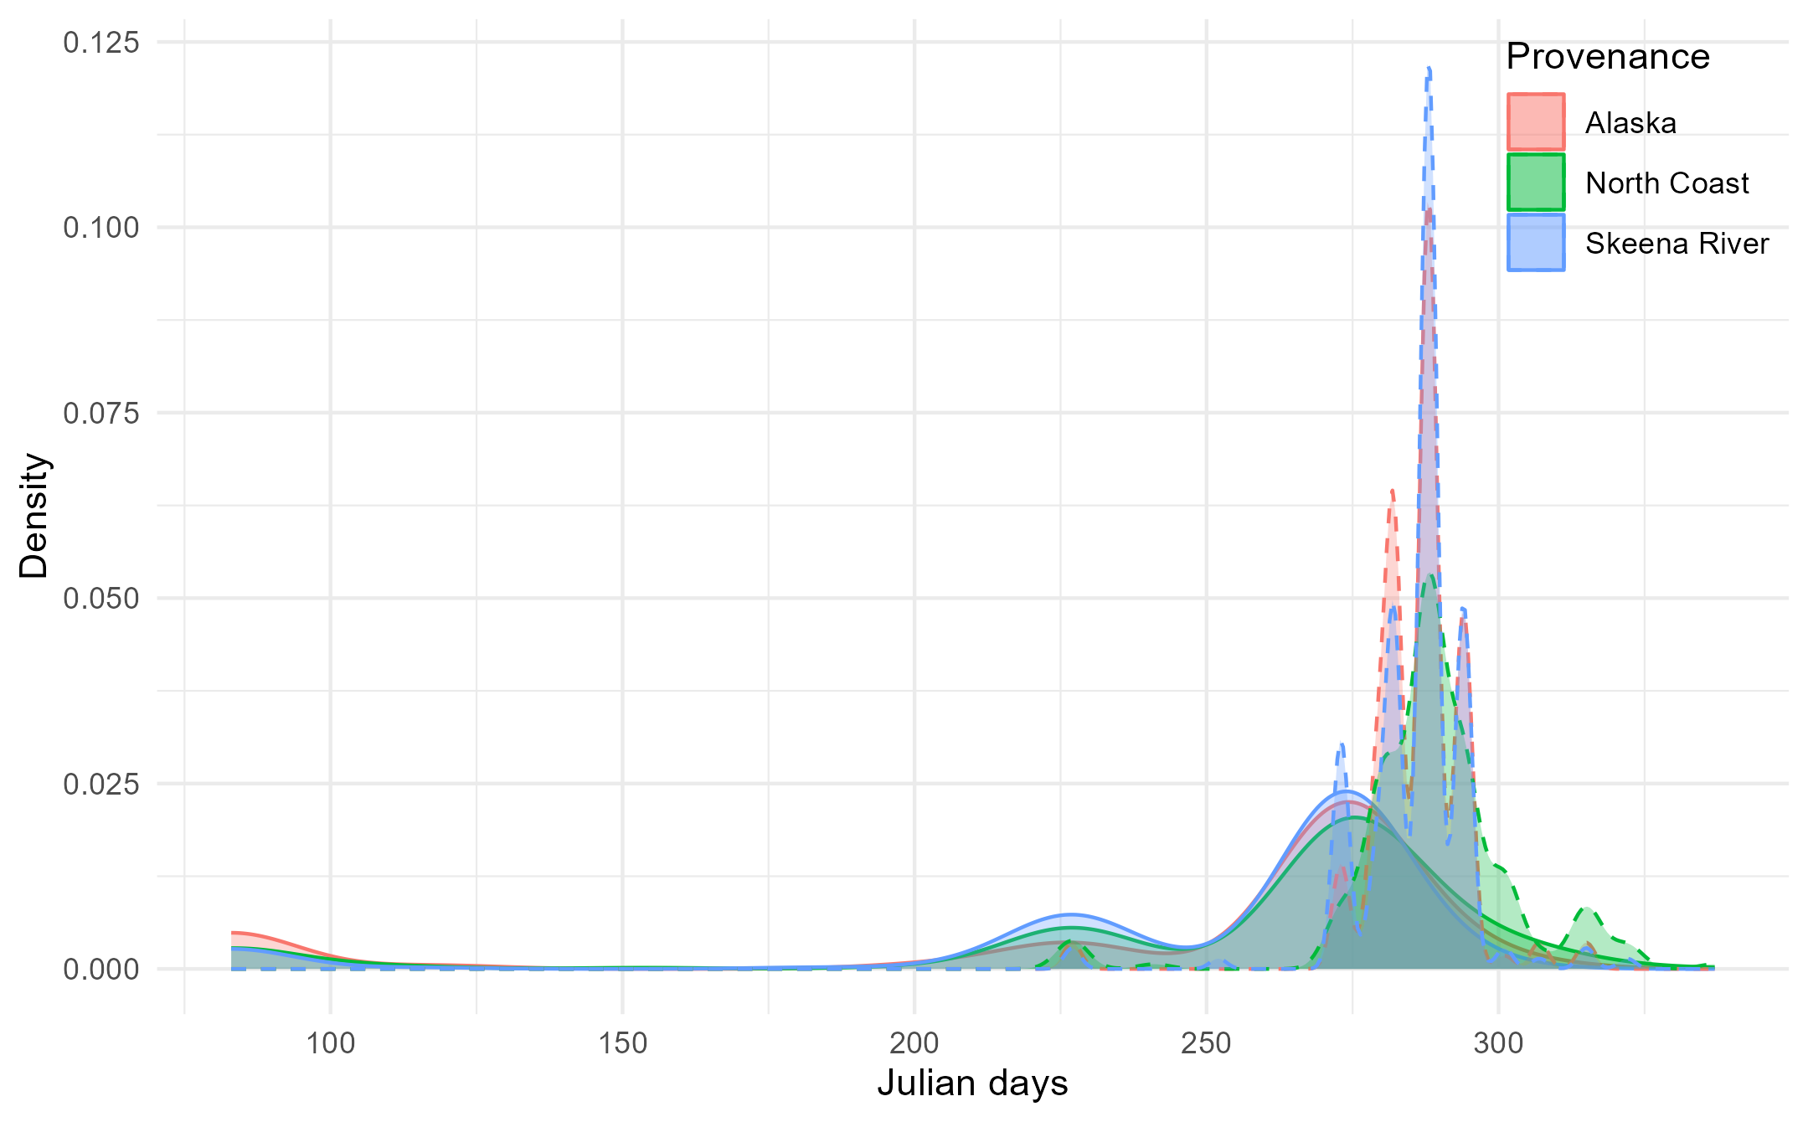
Budset & Budburst - Provenance
Origin date (planting date) = 20/06/2023
Budburst
Budset

Slide 25
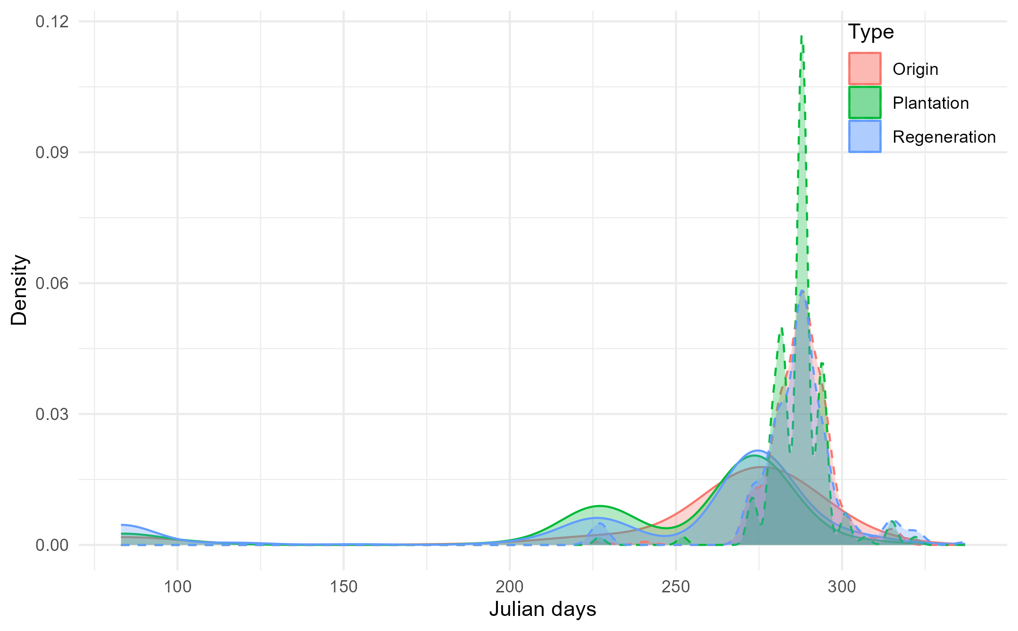
Budset & Budburst - Cohort

Slide 26
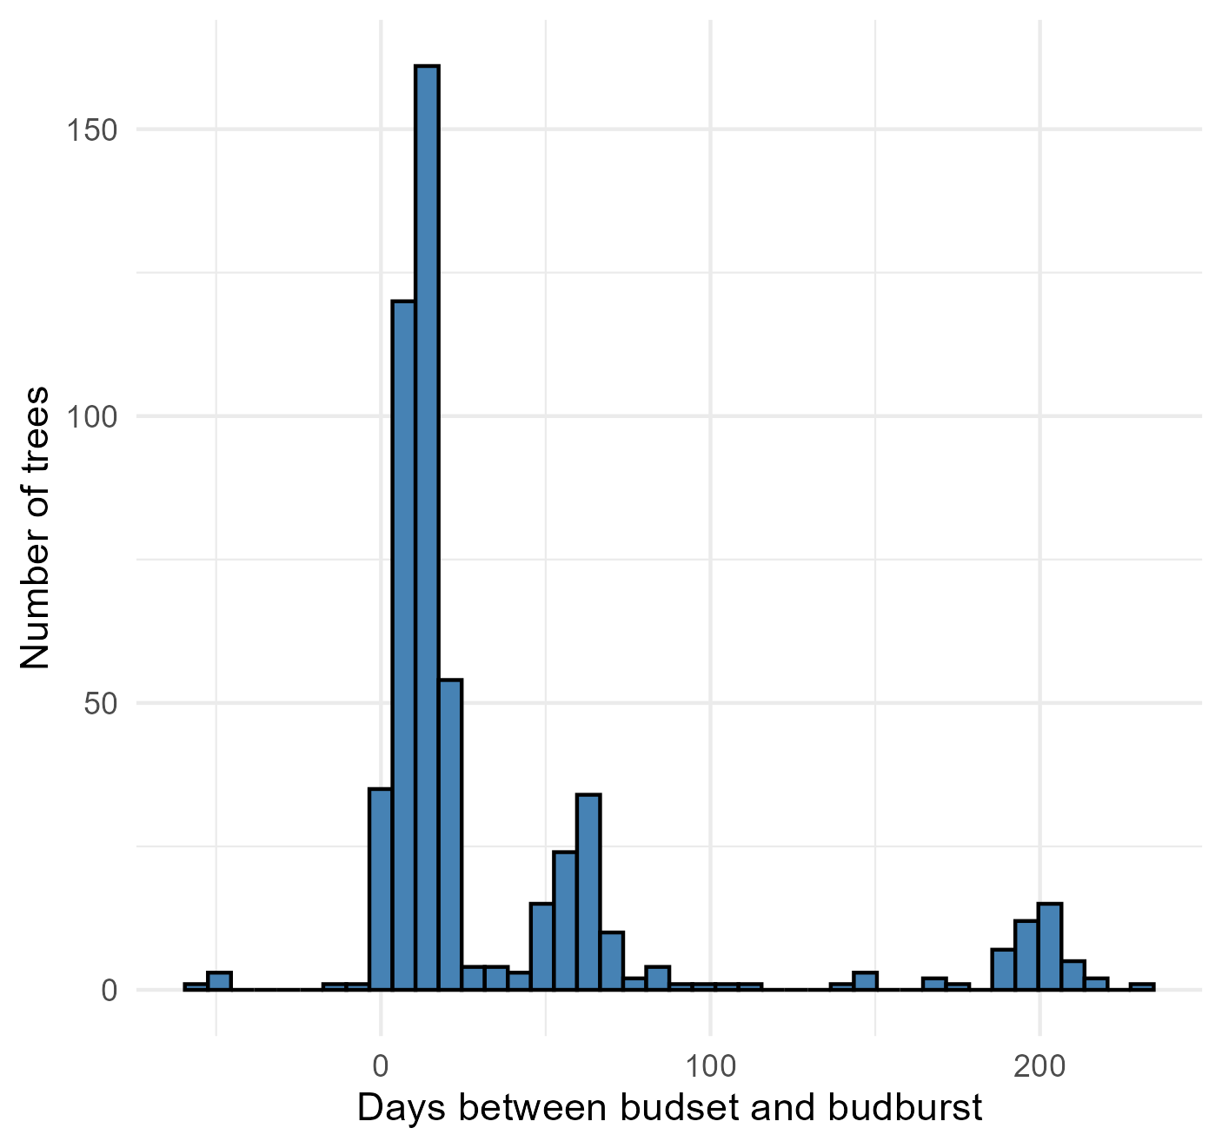
Difference between budset and budburst
no budset recorded, then budset & budburst simultaneously, then "second" budset afterwards??
Probably error in calculating date → check original records
4 Regen (Rowens, North Coast)
6 trees with budset recorded after budburst
1 Plantation (Rowens, North Coast)
1 Origin (Alaska)
Notes:
Plot met office daylength or temperature data

Slide 27
Bioassay analysis
Individual needle scores: how do they progress across time, where do they start where do they end, significantly different between blocks (shouldn’t be)

Slide 28
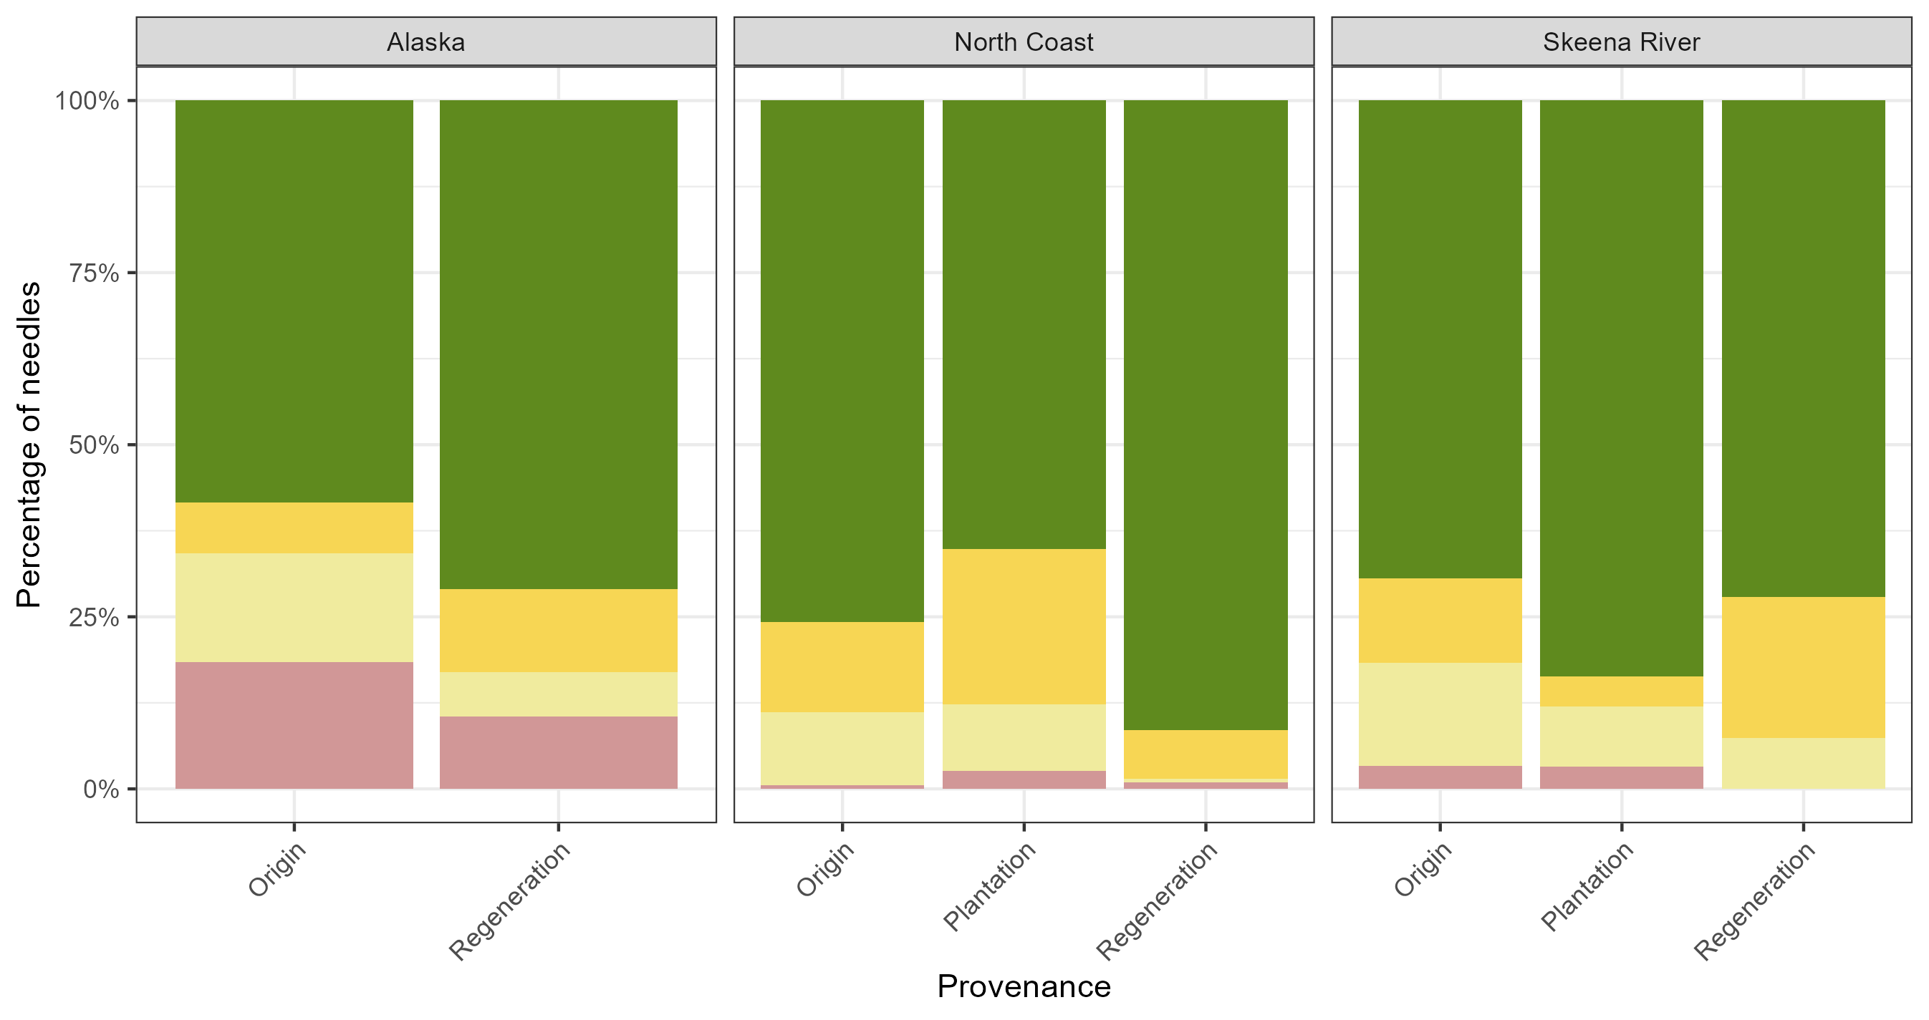
Needle colour – Day 0

Slide 29
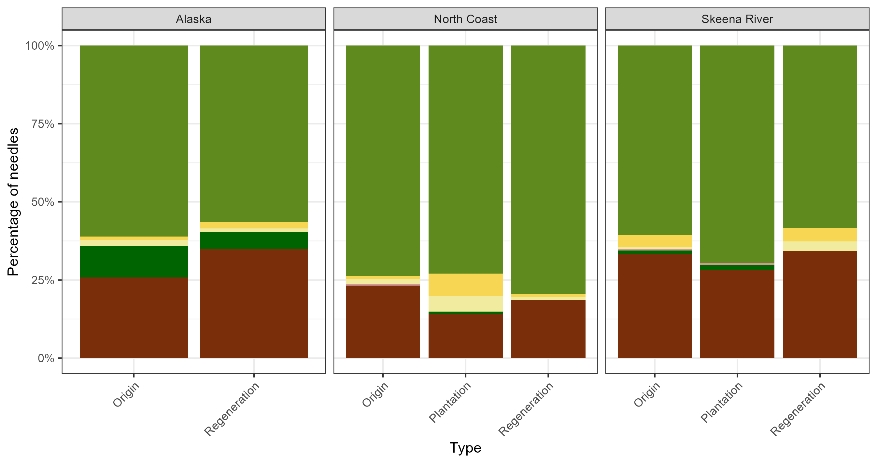
Needle colour – Day 49

Slide 30
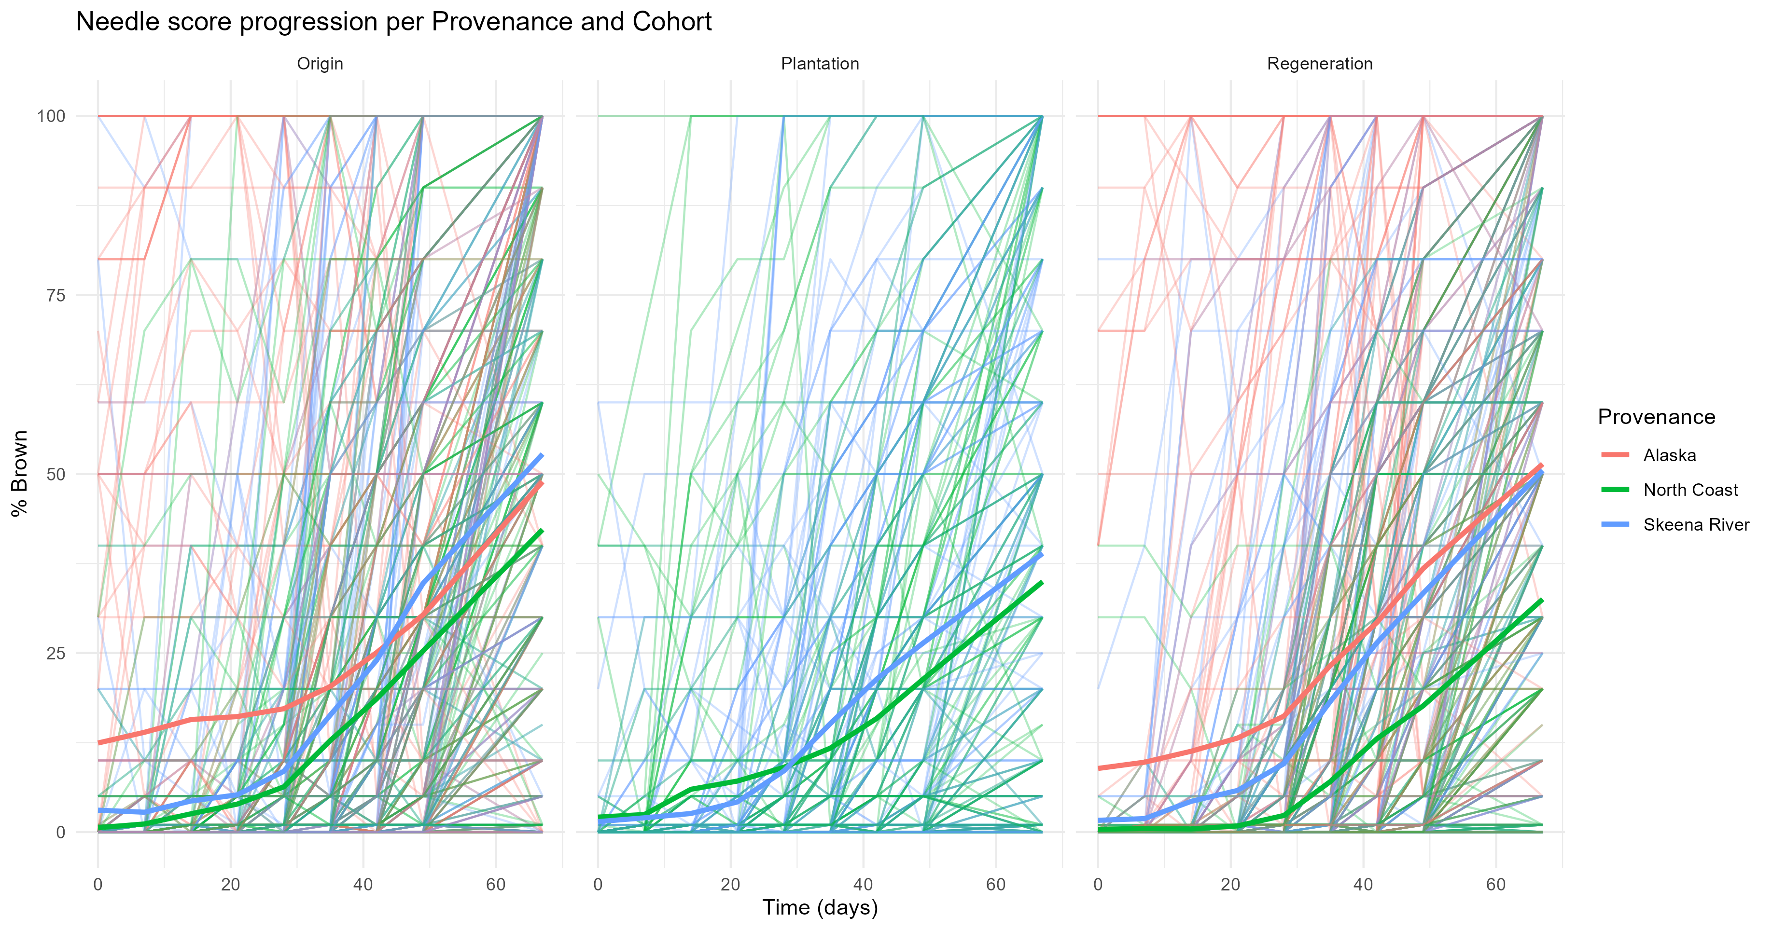

Slide 31
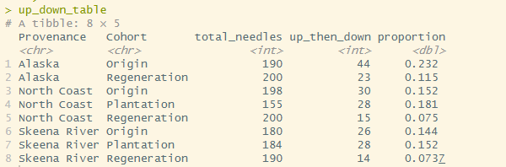
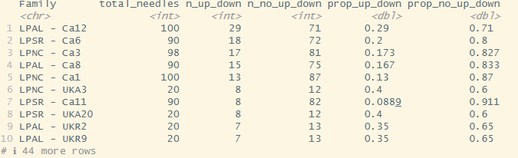
Up then down
+ 44 more rows

Slide 32
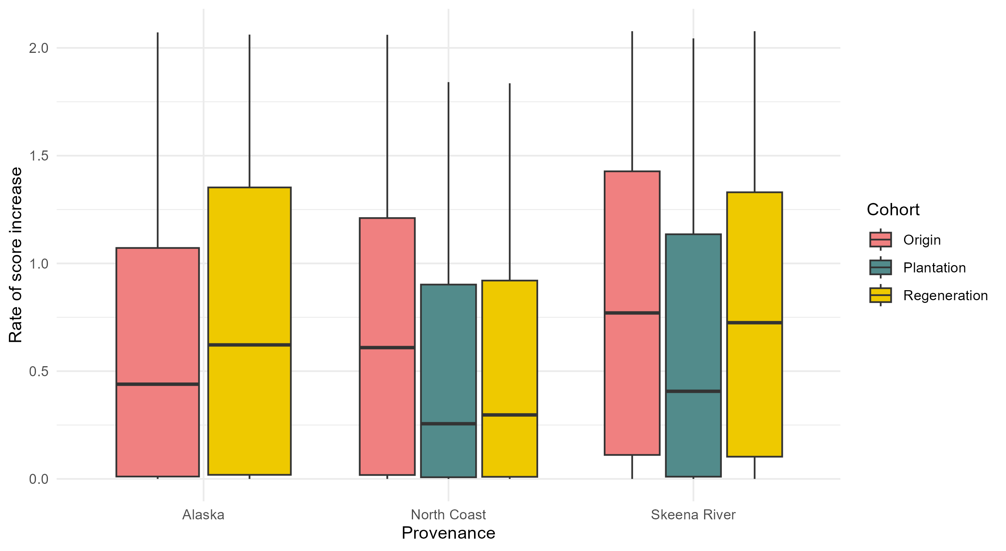
Rate of increase
Removed all needles whose scores decrease at some point
Fitted slope to remained -> slope = rate of increase

Slide 33
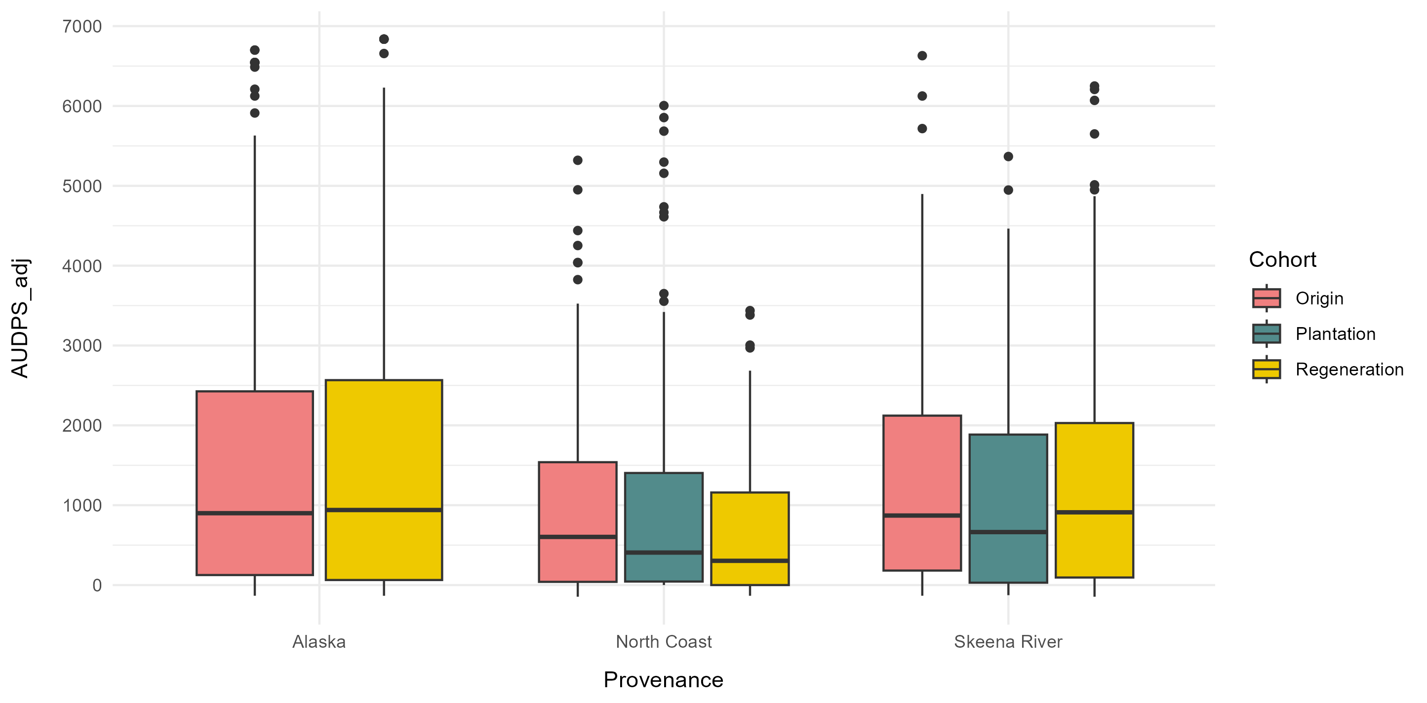
AUDPS (adjusted)

Slide 34
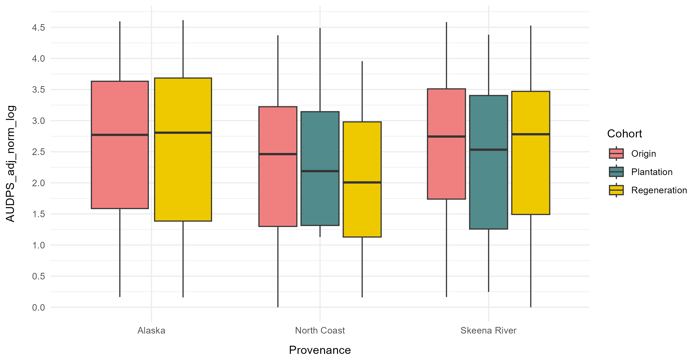
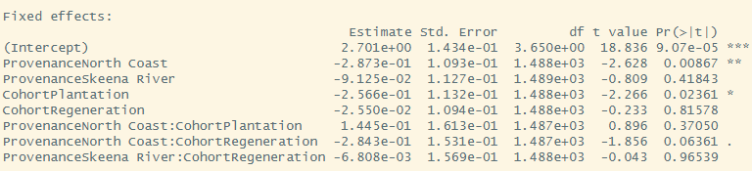
AUDPS (adjusted, standardised, log)
AUDPS_adj_norm_log ~Provenance * Cohort + (1 | Bioassay)

Slide 35
AUDPS by family???

